Slide 1
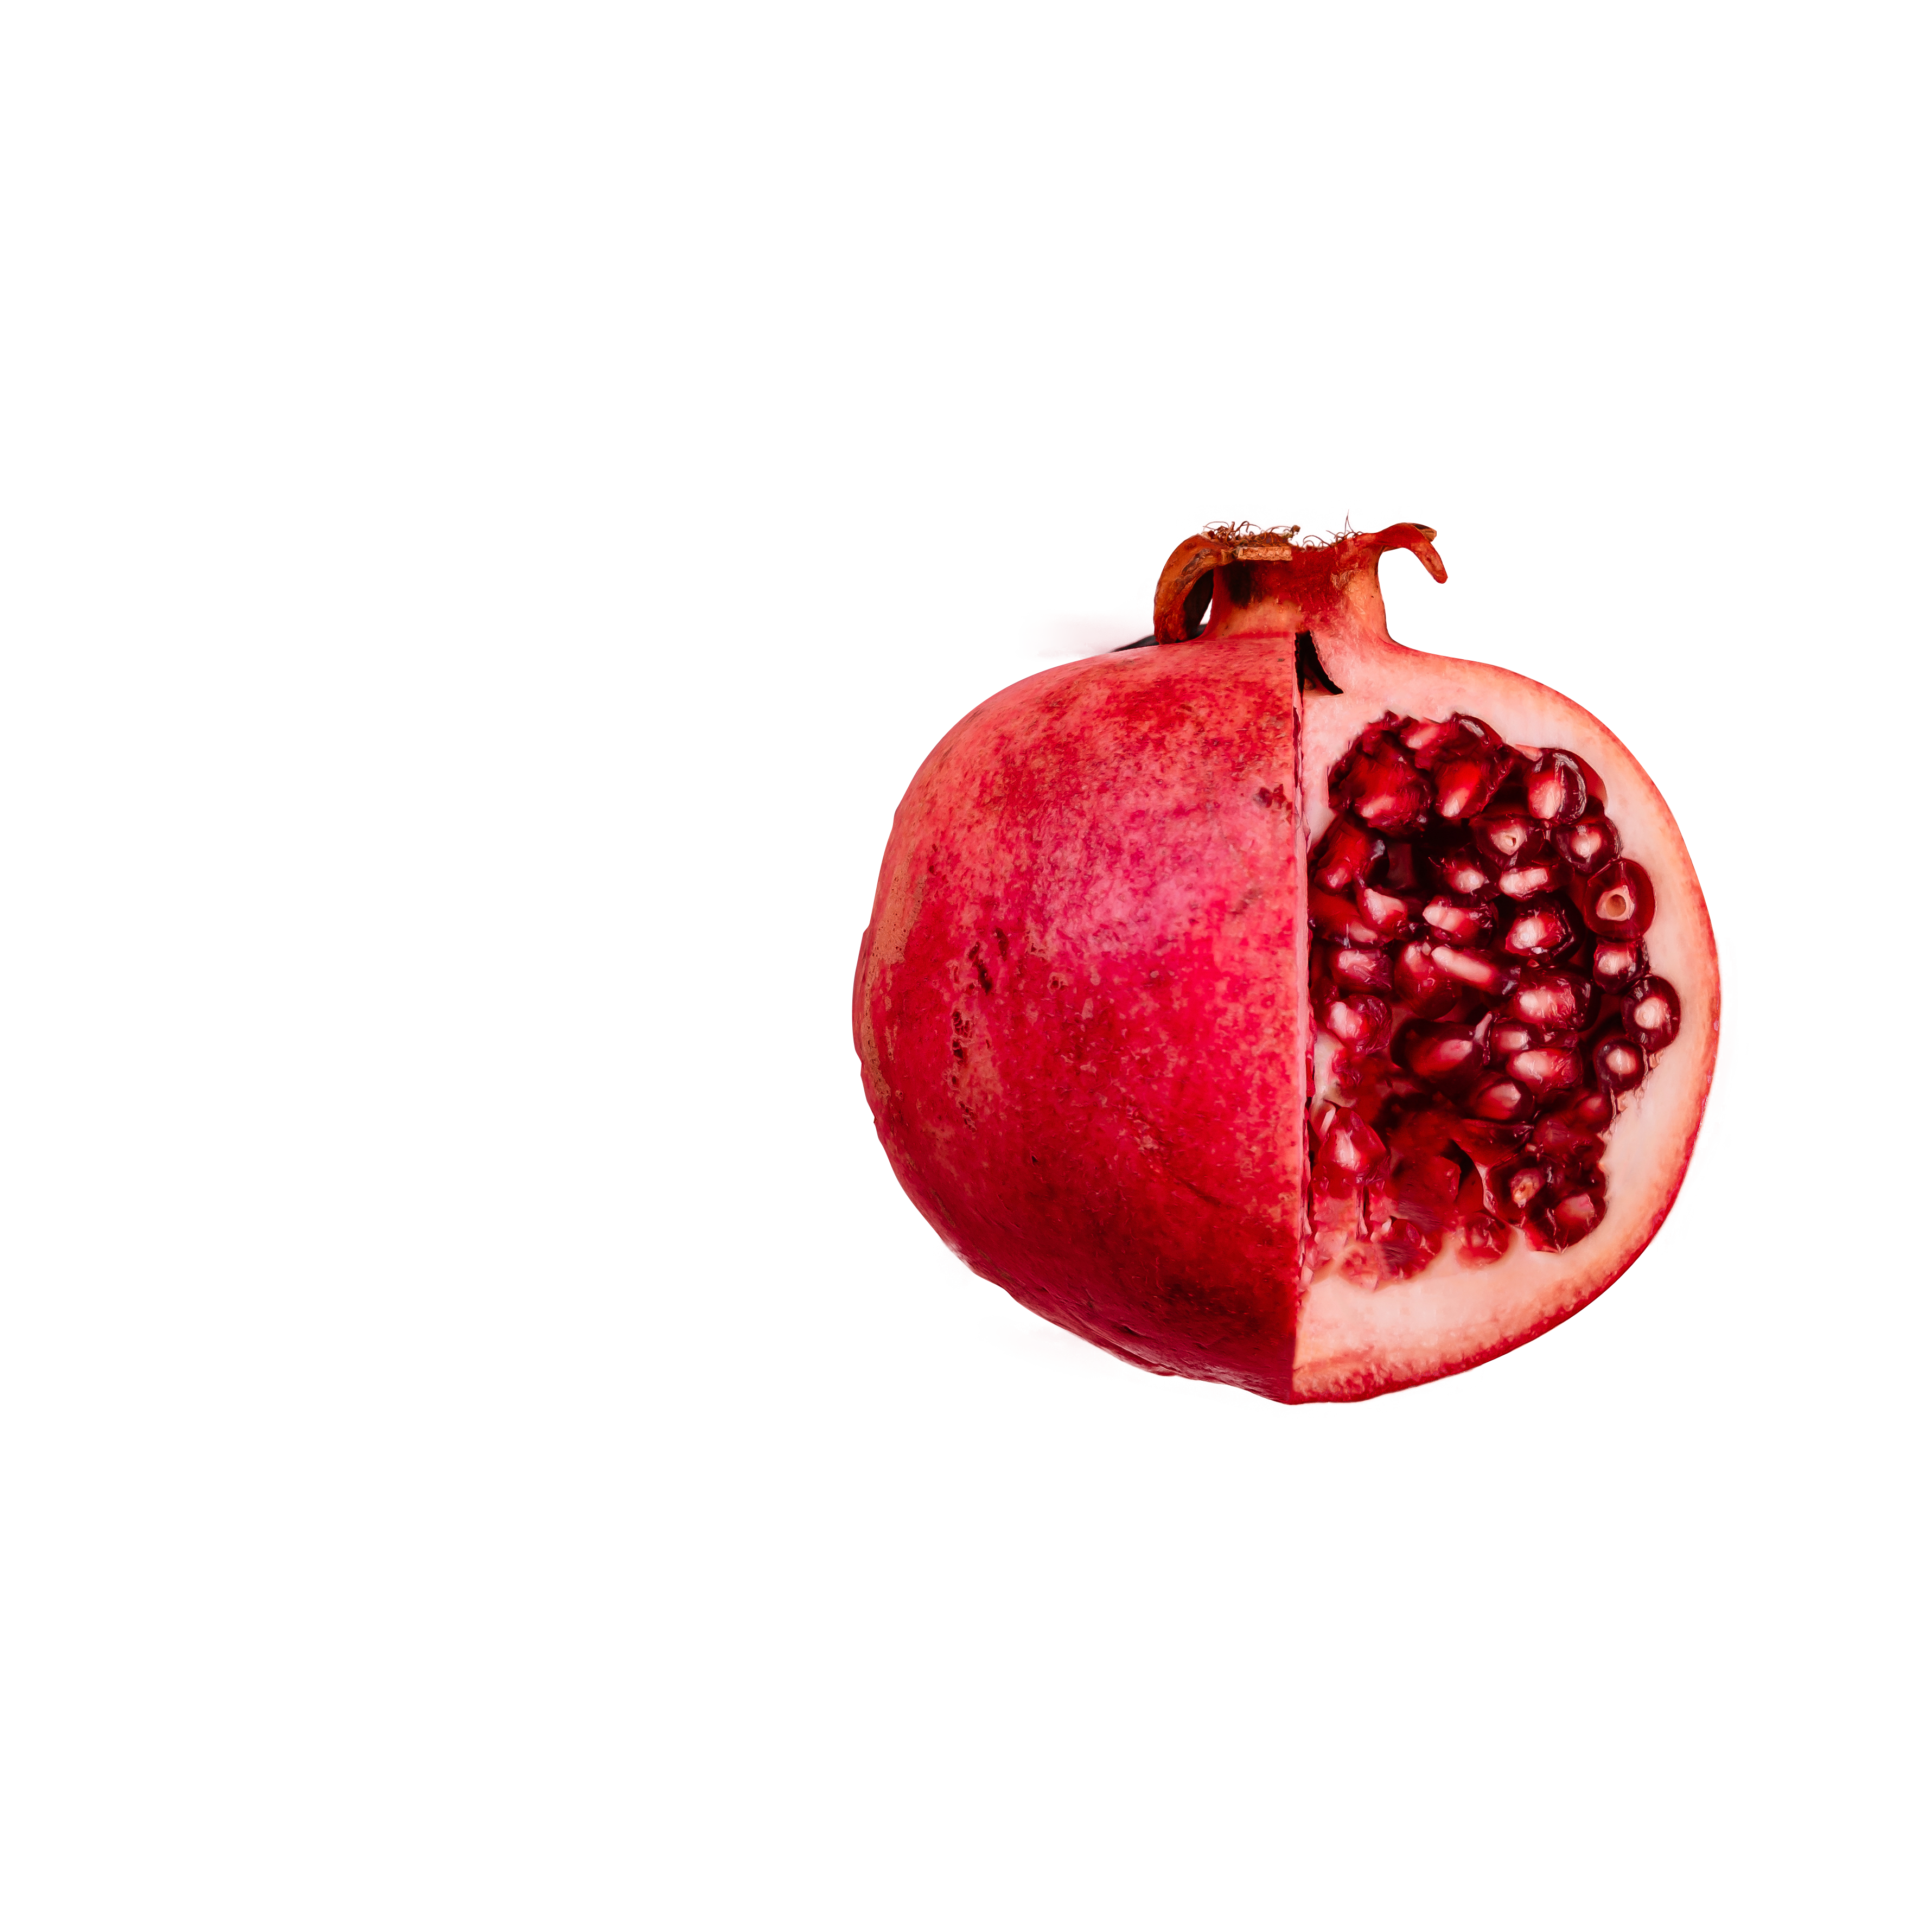



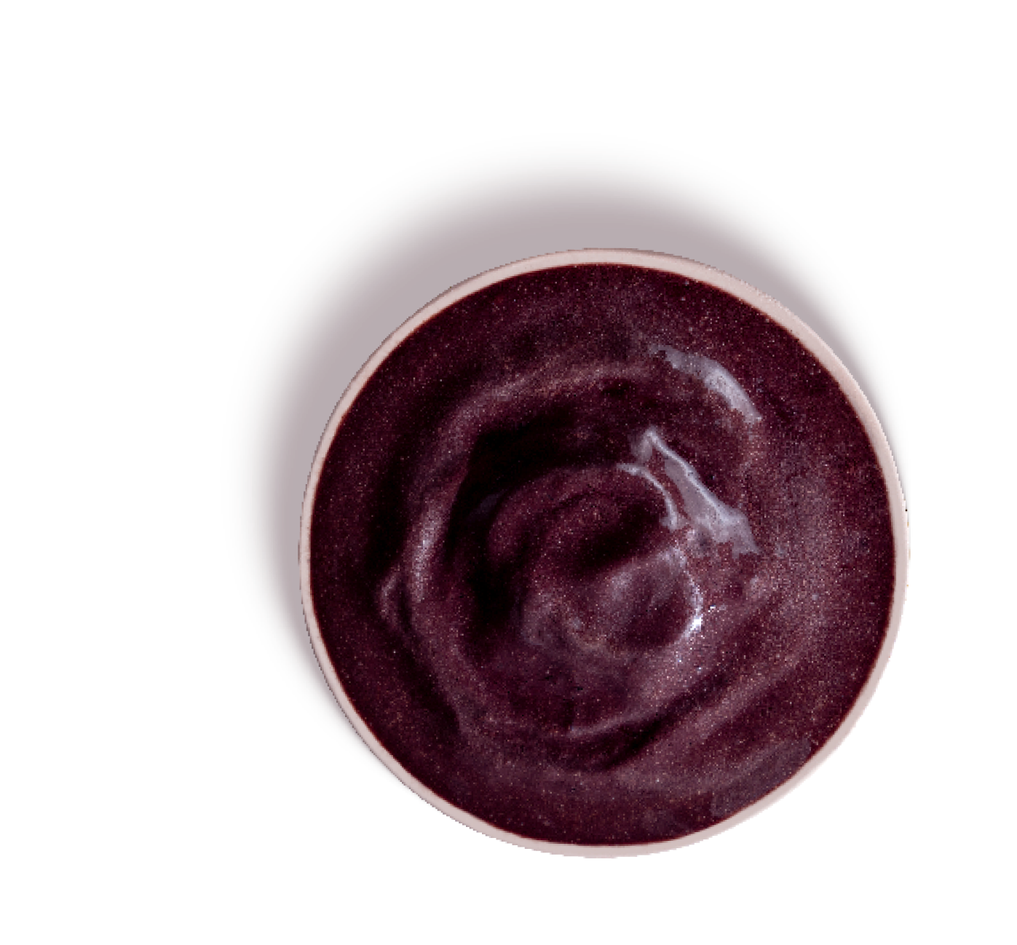

Realização
26 e 27 de Julho | São Paulo
Notes:
1,000-1,100 healthcare professionals; 90% of the public is formed by clinical dietitians.
July 26th 1:50 PM – 14:30PM
Bring the scientific background of your study area
• New publications in these areas
• How supplements can be an allies to achieve results
• How to apply the concept in the clinical practice (strategies, examples, etc) – is there any protocol to follow?
Attention: BR legislation has some substances that are not allowed or in high concentrations needs to be prescribed by a doctor. Important to reinforce that the dietitians needs to adapt the learnings to the local legislation.

Slide 2


DEANNA
MINICH
NUTRICIONISTA
TEMA
Estados Unidos
Mind-Body Medicine for Brain, Heart and Gut

Slide 3
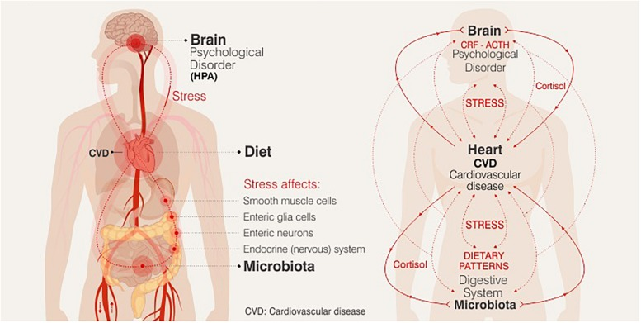
The Master Systems:
Brain, Heart, Gut
Image Credit: Morera LP, Marchiori GN, Medrano LA, Defagó MD. Stress, Dietary Patterns and Cardiovascular Disease: A Mini-Review. Front Neurosci. 2019;13:1226. Published 2019 Nov 12. doi:10.3389/fnins.2019.01226. No changes made. CCBY.
Notes:
Copyright © 2019 Morera, Marchiori, Medrano and Defagó.
This is an open-access article distributed under the terms of the Creative Commons Attribution License (CC BY). The use, distribution or reproduction in other forums is permitted, provided the original author(s) and the copyright owner(s) are credited and that the original publication in this journal is cited, in accordance with accepted academic practice. No use, distribution or reproduction is permitted which does not comply with these terms.

Slide 4
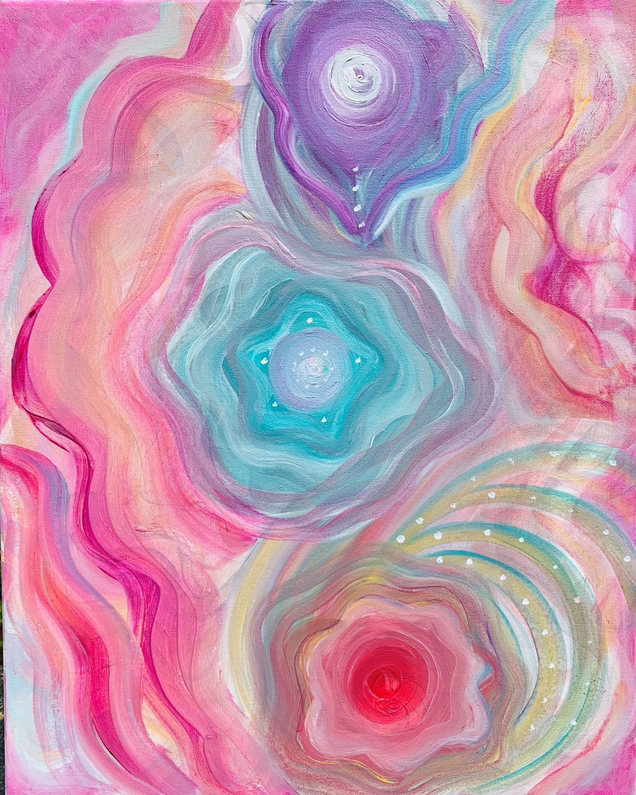
Mind-Body Medicine:
The Symbolism of Systems
Brain: How you think and perceive
Heart: How you feel and connect
Gut: How you sense and digest
Artwork by Deanna Minich

Slide 5

Clinical Conditions
Mind-Body Medicine
Cognitive Impairment
Memory Loss
Dementia
Neurodegenerative Conditions
Attentional Disorders
Mood Disorders
Depression
Anxiety
Brain
Mood, Sleep, Thought

Slide 6
Mind-Body Medicine
Select Root Causes to Address:
Inflammation
Gut microbiome
Nutrient imbalances
Brain
Mood, Sleep, Thought

Slide 7
Inflammation
“Brain on Fire”
Cortisol-insulin-glucose imbalance
Heightened stress response
Greater impulsivity with inflammation¹
Higher cytokines that lead to anger, frustration, fatigue, anxiety & depression²
1. Gassen, J., Prokosch, M. L., et al. (2019). Inflammation predicts decision-making characterized by impulsivity, present focus, and an inability to delay gratification. Scientific Reports, 9(1), 4928. https://doi.org/10.1038/s41598-019-41437-1 PMID: 30894653; 2. Rosenblat, J. D., et al. (2014). Inflamed moods: A review of the interactions between inflammation and mood disorders. Progress in Neuro-Psychopharmacology & Biological Psychiatry, 53, 23–34. https://doi.org/10.1016/j.pnpbp.2014.01.013 PMID: 24468642

Slide 8
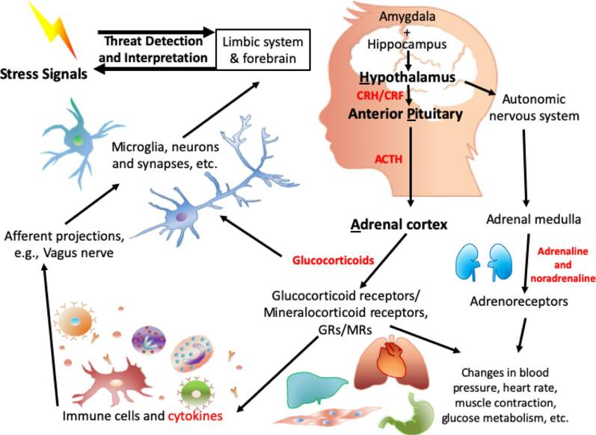
Stress starts in the brain
“Brain on Fire”
Figure from: Jiang S, Postovit L, Cattaneo A, Binder EB, Aitchison KJ. Epigenetic Modifications in Stress Response Genes Associated With Childhood Trauma. Front Psychiatry. 2019;10:808. Published 2019 Nov 8. doi:10.3389/fpsyt.2019.00808; No changes have been made. Copyright © 2019 Jiang, Postovit, Cattaneo, Binder and Aitchison. This is an open-access article distributed under the terms of the Creative Commons Attribution License (CC BY 4.0).

Slide 9
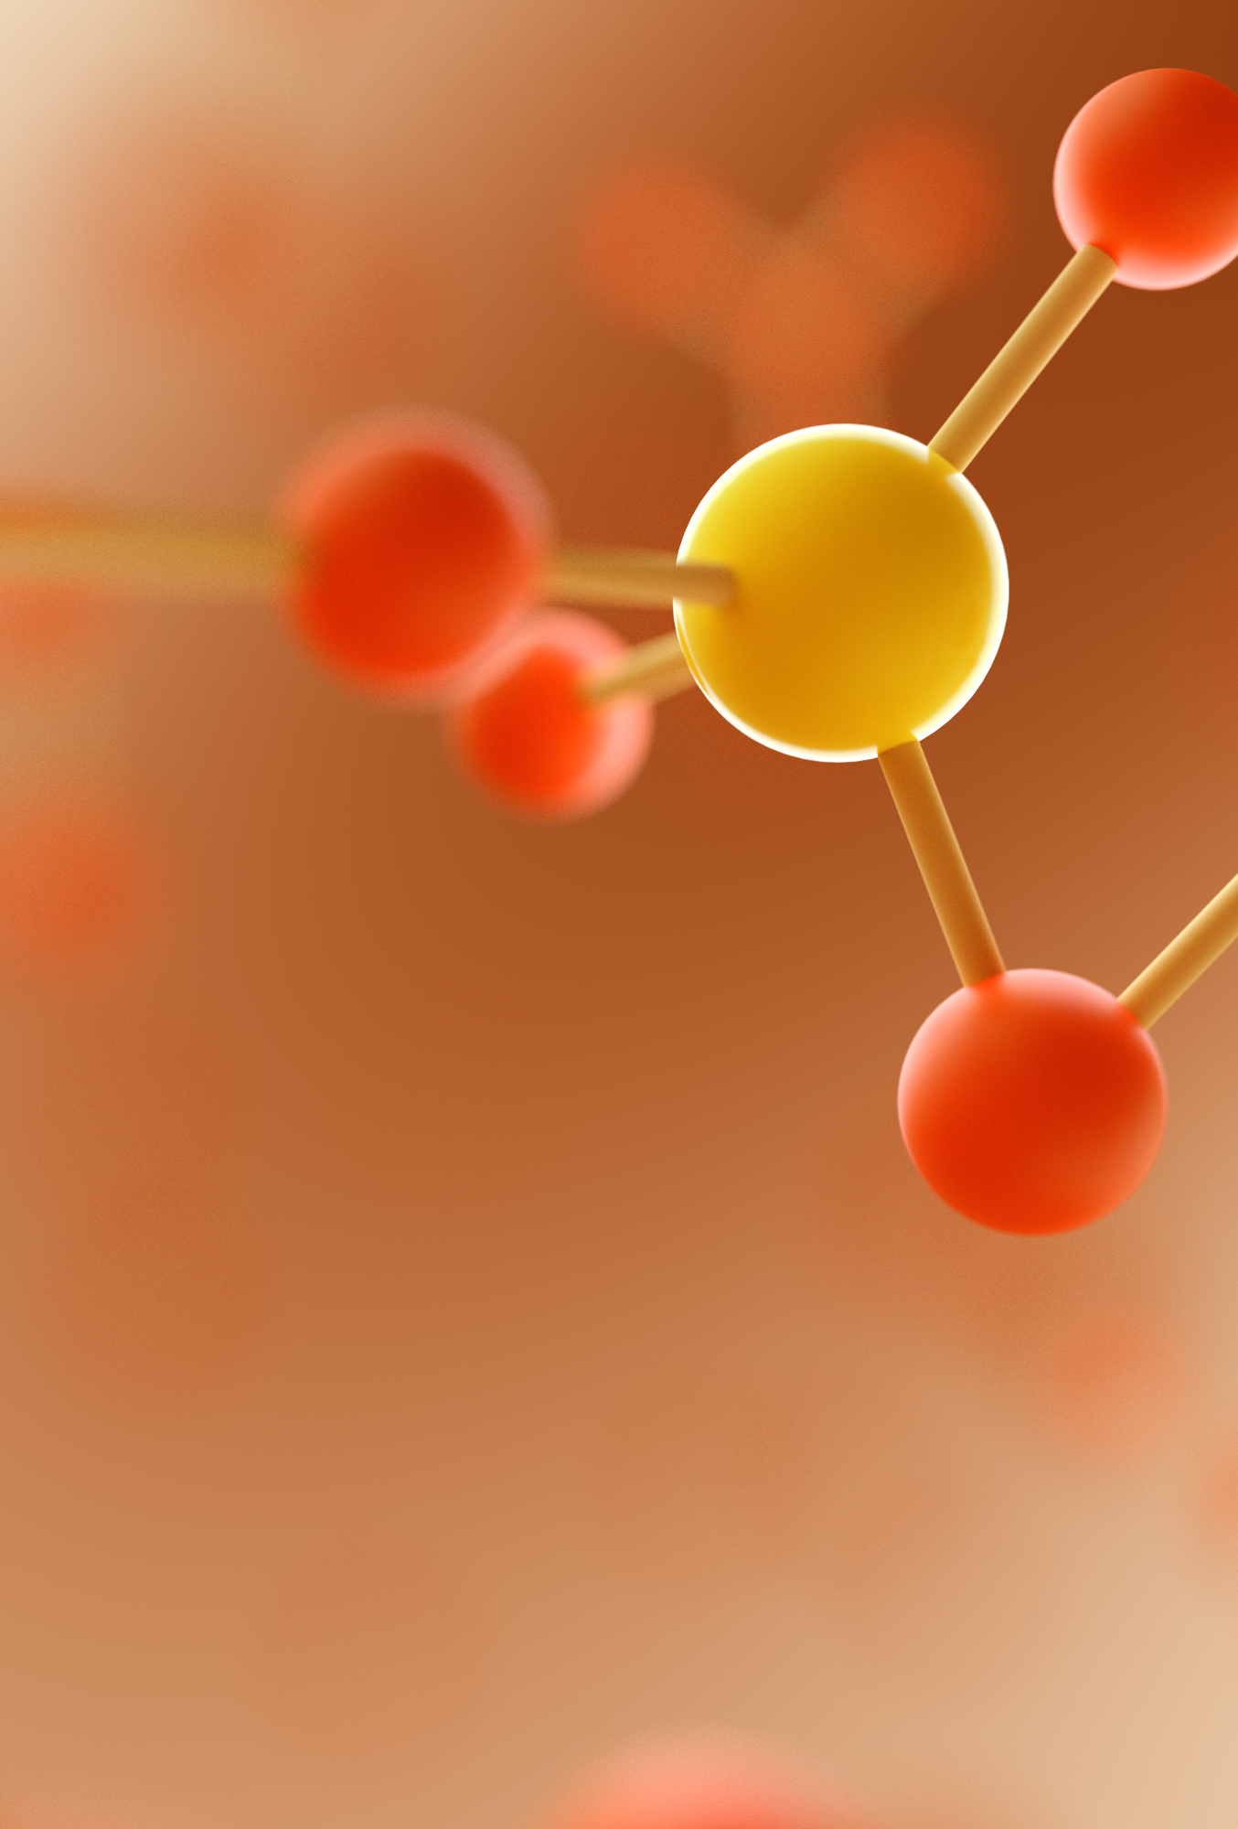
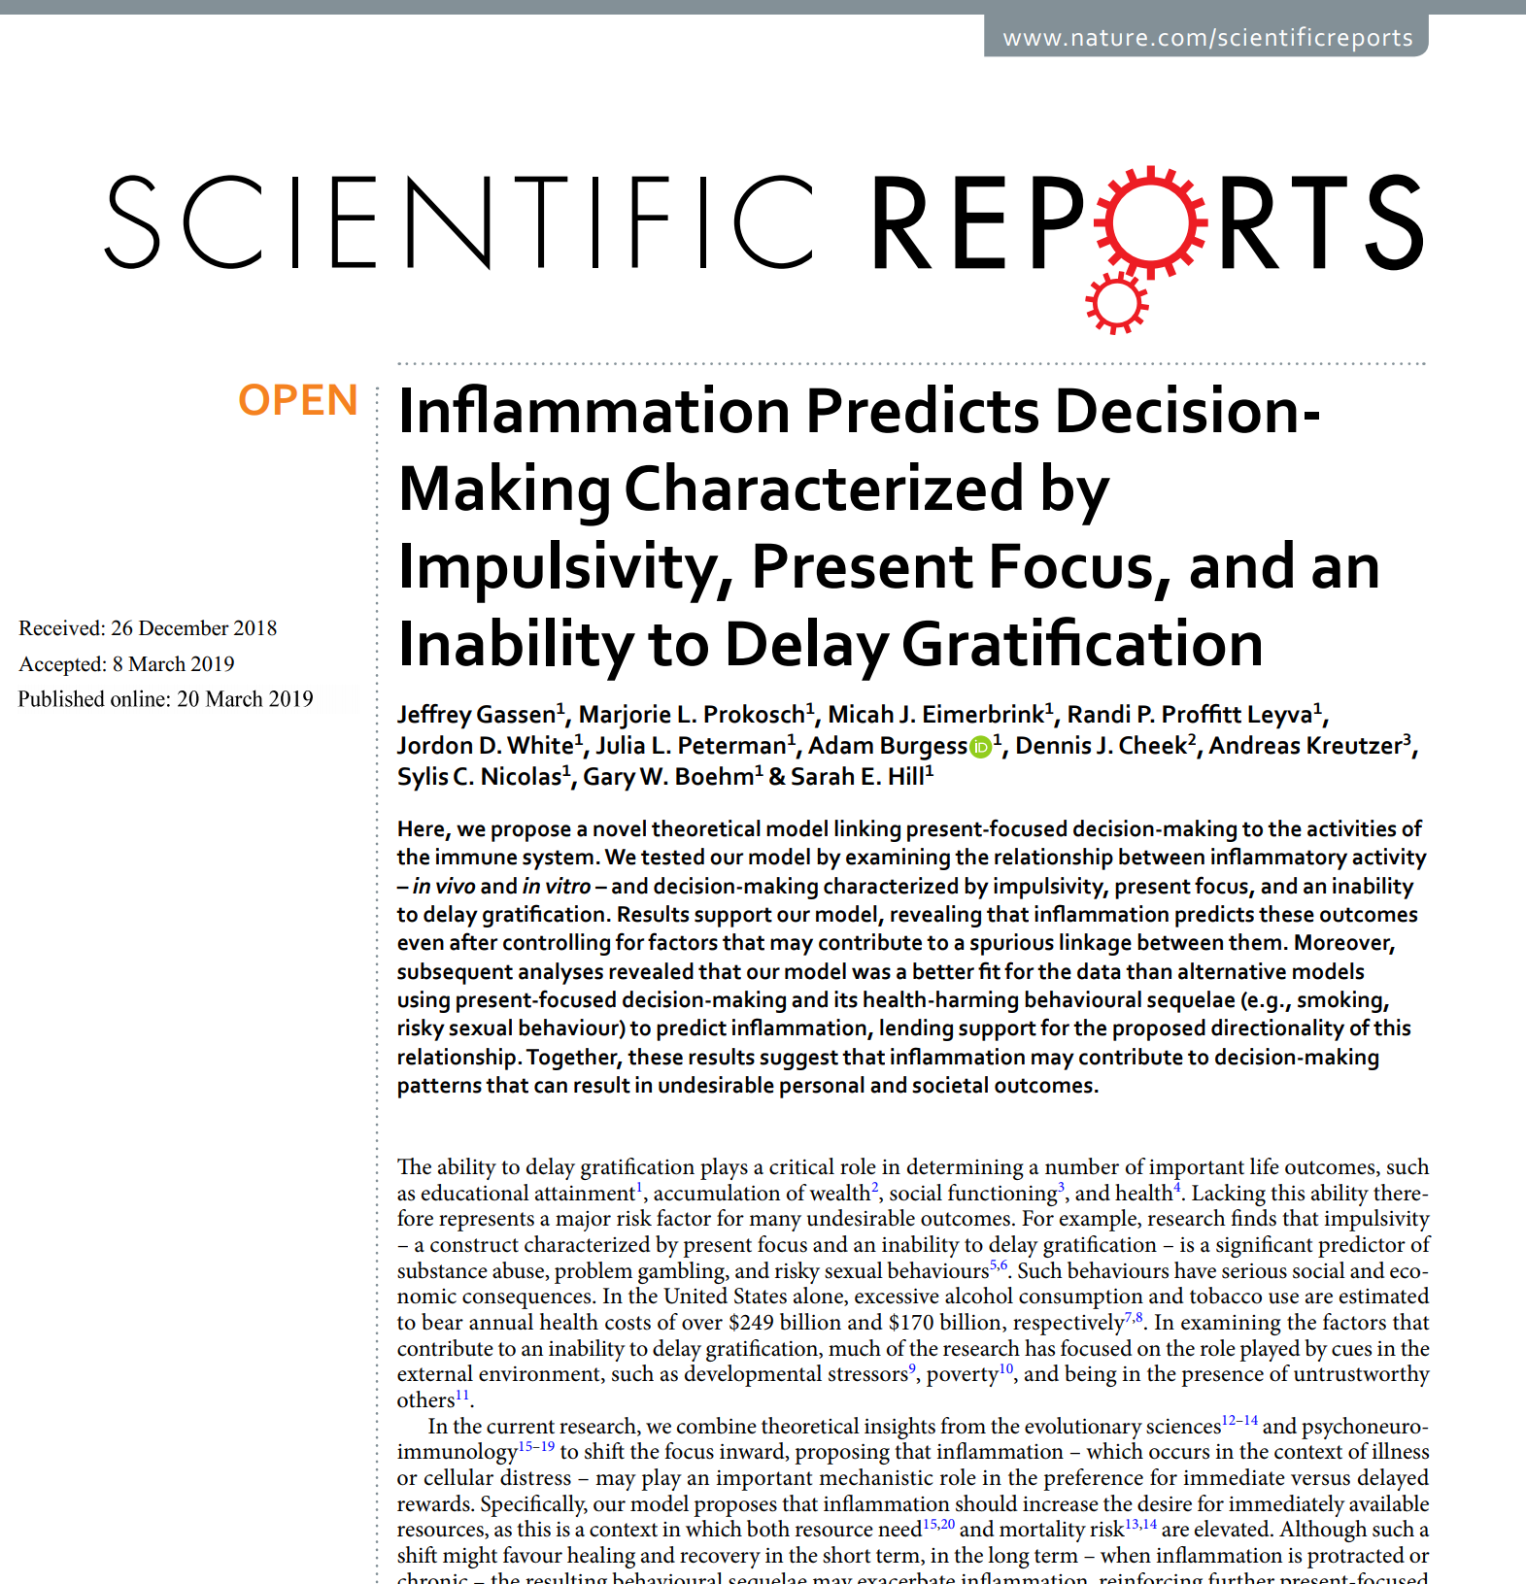
INFLAMMATION
IMPULSIVITY
Behavior & biology are interrelated.
Gassen J, Prokosch ML, Eimerbrink MJ, et al. Inflammation Predicts Decision-Making Characterized by Impulsivity, Present Focus, and an Inability to Delay Gratification. Sci Rep. 2019;9(1):4928. Published 2019 Mar 20. doi:10.1038/s41598-019-41437-1; This article is licensed under a Creative Commons Attribution 4.0 International License

Slide 10
Inflammation can start with food
Glucose
Insulin
Start with the basics of the glucose-insulin-cortisol triad
Cortisol
Fruit juices with added sugar
High-sugar desserts like cakes, cookies, donuts, ice cream, candy
Processed breakfast (warm and cold) cereals
Starchy snack foods like crackers, potato chips, tortilla chips
Starchy vegetables like corn and white potatoes
Processed grain products (e.g., bagels, muffins, sliced bread)
White rice
de Carvalho Vidigal F, Guedes Cocate P, Gonçalves Pereira L, de Cássia Gonçalves Alfenas R. The role of hyperglycemia in the induction of oxidative stress and inflammatory process. Nutr Hosp. 2012 Sep-Oct;27(5):1391-8. doi: 10.3305/nh.2012.27.5.5917. PMID: 23478683.

Slide 11
Reduced neuroinflammation using foods
Foods/drinks to consider for neuroprotective benefit:
  Fermented foods [1]
  Blueberries, berries [2,4]
  Tea/catechins [3]
  Cocoa [4]
  Grapes [5]
  Curcumin [6]
1. PMID: 35624749; 2. PMID: 30999017; 3. PMID: 35647742; 4. PMID: 34539375; 5. PMID: 30614258; 6. PMID: 36221865
Notes:
2. Kumar, M. R., Azizi, N. F., Yeap, S. K., Abdullah, J. O., Khalid, M., Omar, A. R., Osman, M. A., Leow, A. T. C., Mortadza, S. A. S., & Alitheen, N. B. (2022). Clinical and Preclinical Studies of Fermented Foods and Their Effects on Alzheimer's Disease. Antioxidants (Basel, Switzerland), 11(5), 883. https://doi.org/10.3390/antiox11050883. PMID: 35624749
3. Travica, N., D'Cunha, N. M., Naumovski, N., Kent, K., Mellor, D. D., Firth, J., Georgousopoulou, E. N., Dean, O. M., Loughman, A., Jacka, F., & Marx, W. (2020). The effect of blueberry interventions on cognitive performance and mood: A systematic review of randomized controlled trials. Brain, behavior, and immunity, 85, 96–105. https://doi.org/10.1016/j.bbi.2019.04.001. PMID: 30999017
4. Huang, Y., Wei, Y., Xu, J., & Wei, X. (2022). A comprehensive review on the prevention and regulation of Alzheimer's disease by tea and its active ingredients. Critical reviews in food science and nutrition, 1–25. Advance online publication. https://doi.org/10.1080/10408398.2022.2081128. PMID: 35647742
5. Gardener, S. L., Rainey-Smith, S. R., Weinborn, M., Bondonno, C. P., & Martins, R. N. (2021). Intake of Products Containing Anthocyanins, Flavanols, and Flavanones, and Cognitive Function: A Narrative Review. Frontiers in aging neuroscience, 13, 640381. https://doi.org/10.3389/fnagi.2021.640381. PMID: 34539375
6. Zhao, D., Simon, J. E., & Wu, Q. (2020). A critical review on grape polyphenols for neuroprotection: Strategies to enhance bioefficacy. Critical reviews in food science and nutrition, 60(4), 597–625. https://doi.org/10.1080/10408398.2018.1546668 PMID: 30614258
7. Kabir, E. R., Chowdhury, N. M., Yasmin, H., Kabir, M. T., Akter, R., Perveen, A., Ashraf, G. M., Akter, S., Rahman, M. H., & Sweilam, S. H. (2022). Unveiling the Potential of Polyphenols as Anti-Amyloid Molecules in Alzheimer's Disease. Current neuropharmacology, 10.2174/1570159X20666221010113812. Advance online publication. https://doi.org/10.2174/1570159X20666221010113812 PMID: 36221865

Slide 12
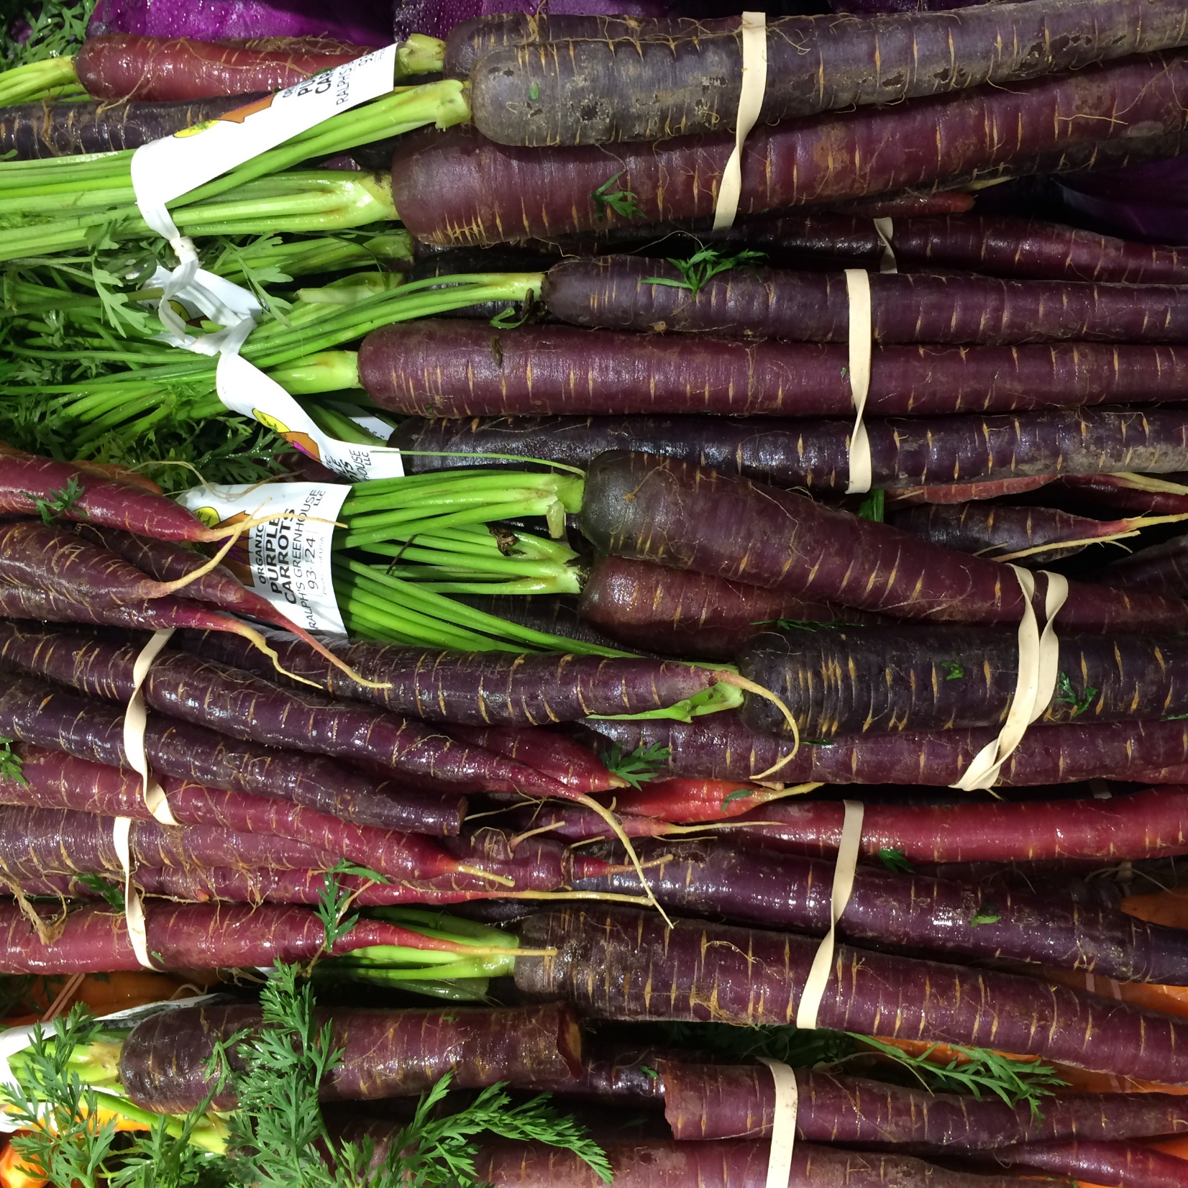
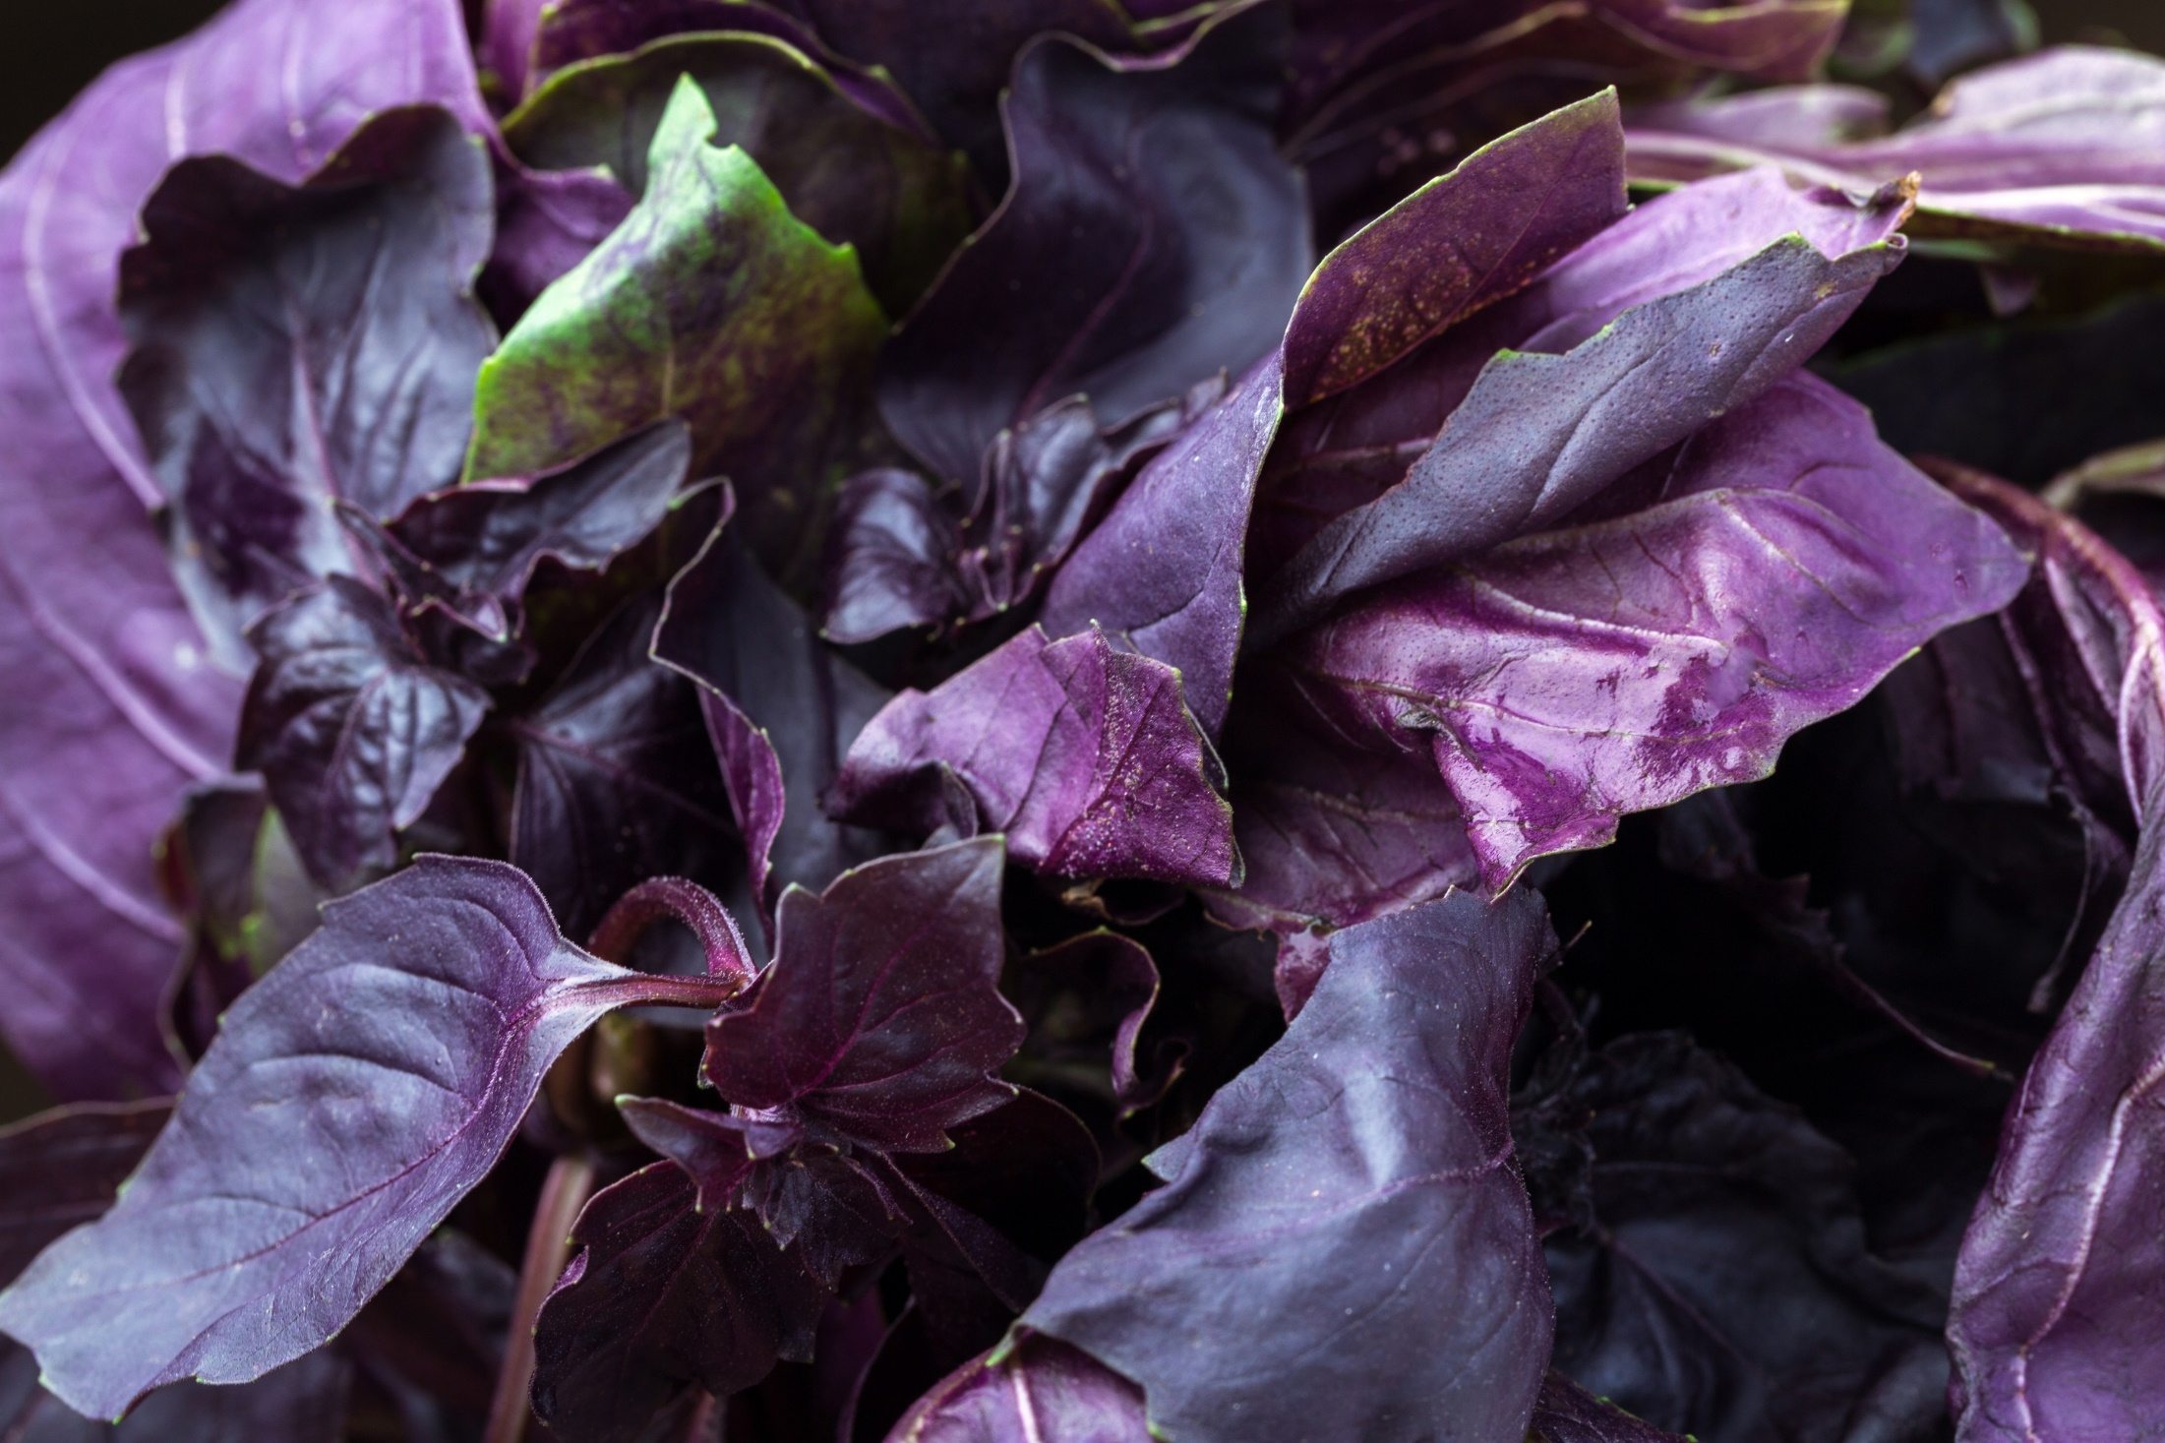
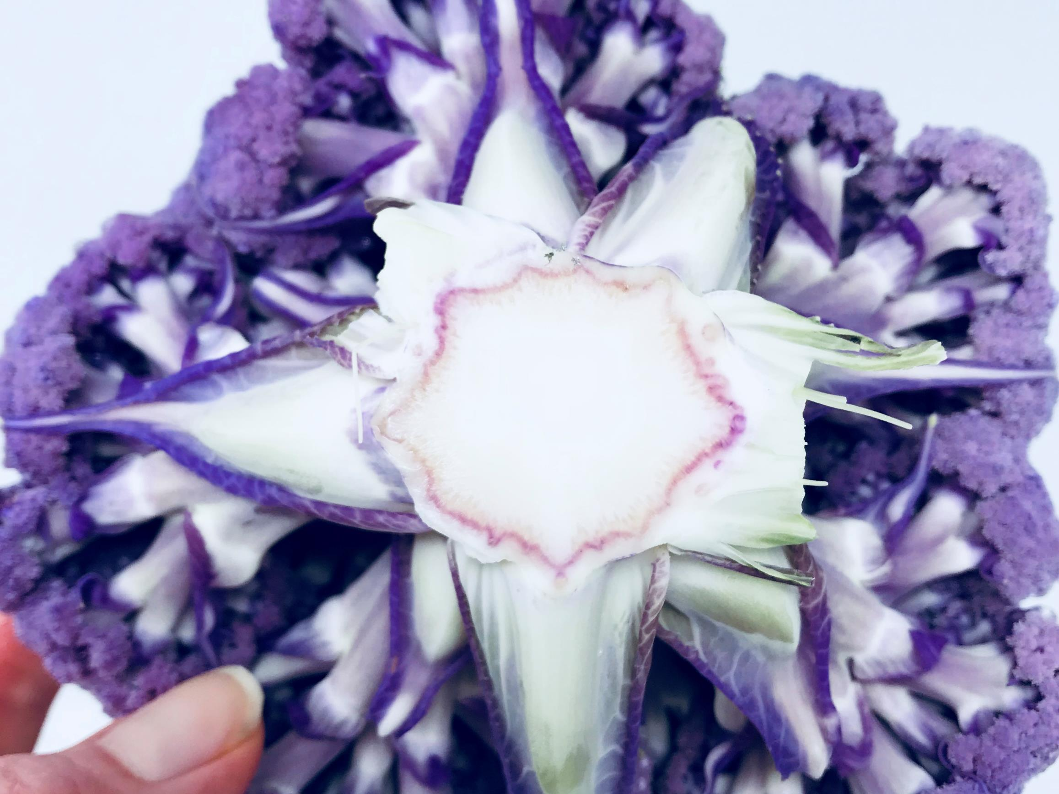
Blue-purple foods for the brain
Color-code for BLUE-PURPLE: Brain, cognition, memory
Minich DM, A Review of the Science of Colorful, Plant-Based Food and Practical Strategies for “Eating the Rainbow”, Journal of Nutrition and Metabolism, vol. 2019, Article ID 2125070, 19 pages, 2019. https://doi.org/10.1155/2019/2125070.

Slide 13
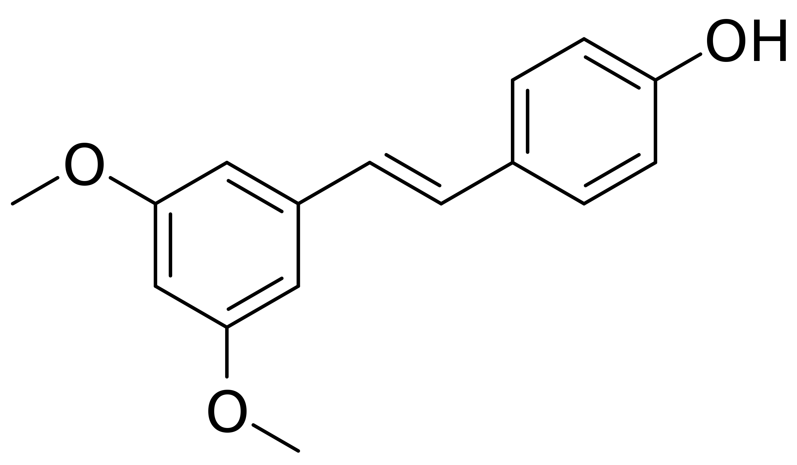
The Color Code of Blue-Purple Foods
Color-code for BLUE-PURPLE: Brain, cognition, memory
Polyphenol-rich
Blueberries and grapes most well studied
Assist with learning, memory, and mood
Contain mood- and brain-modulating flavonoids, procyanidins (monomeric and oligomeric form), flavonols (i.e., kaempferol, quercetin, myricetin), phenolic acids (hydroxycinnamic acids & derivatives of stilbenes)
Pterostilbene
Minich DM, A Review of the Science of Colorful, Plant-Based Food and Practical Strategies for “Eating the Rainbow”, Journal of Nutrition and Metabolism, vol. 2019, Article ID 2125070, 19 pages, 2019. https://doi.org/10.1155/2019/2125070.

Slide 14
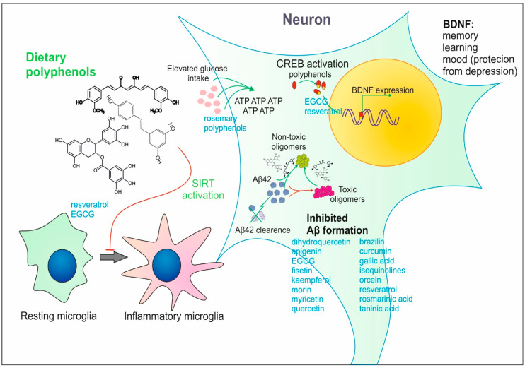
Direct effects of polyphenols on neurons
Grabska-Kobyłecka I, Szpakowski P, Król A, Książek-Winiarek D, Kobyłecki A, Głąbiński A, Nowak D. Polyphenols and Their Impact on the Prevention of Neurodegenerative Diseases and Development. Nutrients. 2023 Aug 4;15(15):3454. doi: 10.3390/nu15153454. PMID: 37571391; PMCID: PMC10420887. Open access CC-BY 4.0.
Notes:
Copyright © 2023 by the authors.
Licensee MDPI, Basel, Switzerland. This article is an open access article distributed under the terms and conditions of the Creative Commons Attribution (CC BY) license (https://creativecommons.org/licenses/by/4.0/).

Slide 15
Blue-purple fruits & vegetables, select phytochemicals & physiological effects
Color-code for BLUE-PURPLE: Brain, cognition, memory
Color | Fruits | Vegetables | Select Phytochemicals | Physiological Effects
Blue-purple | Blackberries Blueberries Boysenberries Figs Huckleberries Plums Prunes Purple grapes Raisins | Eggplant Purple bell peppers Purple cabbage Purple carrots Purple cauliflower Purple kale Purple potatoes | Anthocyanidins Flavonoids Phenolic acids Proanthocyanidins Pterostilbene Resveratrol Stilbenes | Antioxidant Cognitive support Healthy mood balance Neuronal health
Minich DM, A Review of the Science of Colorful, Plant-Based Food and Practical Strategies for “Eating the Rainbow”, Journal of Nutrition and Metabolism, vol. 2019, Article ID 2125070, 19 pages, 2019. https://doi.org/10.1155/2019/2125070.

Slide 16
Concord Grape Juice (Resveratrol)
Color-code for BLUE-PURPLE: Brain, cognition, memory
Daily intake shown to improve memory in adults with mild cognitive impairment.
Can help with other parameters of cognition including reactive time on an attention measure and increased calm ratings
An animal study suggests it may modulate BDNF, a neuronal growth factor
Grape polyphenols like resveratrol have been shown to have anti-inflammatory effects.
Minich DM, A Review of the Science of Colorful, Plant-Based Food and Practical Strategies for “Eating the Rainbow”, Journal of Nutrition and Metabolism, vol. 2019, Article ID 2125070, 19 pages, 2019. https://doi.org/10.1155/2019/2125070.

Slide 17
Blueberries (Pterostilbenes)
Color-code for BLUE-PURPLE: Brain, cognition, memory
Involved in inflammation and cell survival; enhance neuroplasticity, neurotransmission
Reduce glycation
Reduce DNA damage
Improves spatial memory, increases rate of learning, elevates BDNF (animals)
Improves cognition in older adults and in children
Improved positive affect/mood in children/young adults
PMID: 33414957, 28230732, 30327868, 29152239, 23723987
Notes:
Minich DM, A Review of the Science of Colorful, Plant-Based Food and Practical Strategies for “Eating the Rainbow”, Journal of Nutrition and Metabolism, vol. 2019, Article ID 2125070, 19 pages, 2019.. https://doi.org/10.1155/2019/2125070, PMID: 33414957
Khalid S, Barfoot KL, May G, et al. Effects of acute blueberry flavonoids on mood in children and young adults. Nutrients. 2017;9(2):158. Published 2017 Feb 20. doi:10.3390/nu9020158. PMID: 28230732
Barfoot KL, May G, Lamport DJ, Ricketts J, Riddell PM, Williams CM. The effects of acute wild blueberry supplementation on the cognition of 7-10-year-old schoolchildren. Eur J Nutr. 2019;58(7):2911–2920. doi:10.1007/s00394-018-1843-6. PMID: 30327868
Fragua V, Lepoudère A, Leray V, et al. Effects of dietary supplementation with a mixed blueberry and grape extract on working memory in aged beagle dogs. J Nutr Sci. 2017;6:e35. Published 2017 Jul 12. doi:10.1017/jns.2017.33. PMID: 29152239
Rendeiro C, Vauzour D, Rattray M, et al. Dietary levels of pure flavonoids improve spatial memory performance and increase hippocampal brain-derived neurotrophic factor. PLoS One. 2013;8(5):e63535. Published 2013 May 28. doi:10.1371/journal.pone.0063535, PMID: 23723987

Slide 18
Consider total amount and balance of omega-3 fatty acids
For many people eating a processed food diet, dietary omega-6 fats exceed that of omega-3 fats.
The current n-6/n-3 ratio is 20-50/1.
Higher ratios of n-6/n-3 in modern diets translate into greater allergic, inflammatory, proliferative, and cardiovascular symptoms.
Recommendation would be to keep n-6/n-3 ratio at 4-5/1.
Mariamenatu AH, Abdu EM. Overconsumption of Omega-6 Polyunsaturated Fatty Acids (PUFAs) versus Deficiency of Omega-3 PUFAs in Modern-Day Diets: The Disturbing Factor for Their "Balanced Antagonistic Metabolic Functions" in the Human Body. J Lipids. 2021 Mar 17;2021:8848161. doi: 10.1155/2021/8848161. PMID: 33815845; PMCID: PMC7990530.
Notes:
This is an open access article distributed under the Creative Commons Attribution License, which permits unrestricted use, distribution, and reproduction in any medium, provided the original work is properly cited.

Slide 19
Gut Microbiome
“Leaky gut, leaky brain”¹
Dysbiosis ²
Lipopolysaccharide (LPS) and metabolic endotoxemia³
Imbalance in microbiome diversity⁴
Lack of dietary prebiotic fiber to supply SCFAs, which help promote production of BDNF (dysbiosis decreases BDNF)²
1. PMID: 30340384; 2. PMID: 35163104; 3. PMID: 33505393; 4. PMID: 29397391
Notes:
Obrenovich, M. (2018). Leaky gut, leaky brain? Microorganisms, 6(4), 107. https://doi.org/10.3390/microorganisms6040107 PMID: 30340384;
2. Suda, K., & Matsuda, K. (2022). How microbes affect depression: Underlying mechanisms via the gut-brain axis and the modulating role of probiotics. International Journal of Molecular Sciences, 23(3), 1172. https://doi.org/10.3390/ijms23031172 PMID: 35163104;
3. Mohammad, S., & Thiemermann, C. (2021). Role of metabolic endotoxemia in systemic inflammation and potential interventions. Frontiers in Immunology, 11, 594150. https://doi.org/10.3389/fimmu.2020.594150 PMID: 33505393;
4. Winter, G., et al. (2018). Gut microbiome and depression: What we know and what we need to know. Reviews in the Neurosciences, 29(6), 629–643. https://doi.org/10.1515/revneuro-2017-0072 PMID: 29397391

Slide 20
“Leaky brain”
“In depressed patients, there is also evidence of increased blood-brain-barrier (BBB) permeability (Bechter et al., 2010) and through a compromised BBB, cytokines and chemokines infiltrate the CNS, stimulating microglia and astrocyte activation (Wohleb et al., 2016).”
Westfall S, Pasinetti GM. The gut microbiota links dietary polyphenols with management of psychiatric mood disorders. Front Neurosci. 2019;13:1196. Published 2019 Nov 5. doi:10.3389/fnins.2019.01196
Notes:
Copyright © 2019 Westfall and Pasinetti. This is an open-access article distributed under the terms of the Creative Commons Attribution License (CC BY). The use, distribution or reproduction in other forums is permitted, provided the original author(s) and the copyright owner(s) are credited and that the original publication in this journal is cited, in accordance with accepted academic practice. No use, distribution or reproduction is permitted which does not comply with these terms. Attribution 4.0 International (CC BY 4.0)
You are free to:
Share — copy and redistribute the material in any medium or format
Adapt — remix, transform, and build upon the material for any purpose, even commercially.
____
Abstract
The pathophysiology of depression is multifactorial yet generally aggravated by stress and its associated physiological consequences. To effectively treat these diverse risk factors, a broad acting strategy is required and is has been suggested that gut-brain-axis signaling may play a pinnacle role in promoting resilience to several of these stress-induced changes including pathogenic load, inflammation, HPA-axis activation, oxidative stress and neurotransmitter imbalances. The gut microbiota also manages the bioaccessibility of phenolic metabolites from dietary polyphenols whose multiple beneficial properties have known therapeutic efficacy against depression. Although several potential therapeutic mechanisms of dietary polyphenols toward establishing cognitive resilience to neuropsychiatric disorders have been established, only a handful of studies have systematically identified how the interaction of the gut microbiota with dietary polyphenols can synergistically alleviate the biological signatures of depression. The current review investigates several of these potential mechanisms and how synbiotics, that combine probiotics with dietary polyphenols, may provide a novel therapeutic strategy for depression. In particular, synbiotics have the potential to alleviate neuroinflammation by modulating microglial and inflammasome activation, reduce oxidative stress and balance serotonin metabolism therefore simultaneously targeting several of the major pathological risk factors of depression. Overall, synbiotics may act as a novel therapeutic paradigm for neuropsychiatric disorders and further understanding the fundamental mechanisms of gut-brain-axis signaling will allow full utilization of the gut microbiota's as a therapeutic tool.

Slide 21
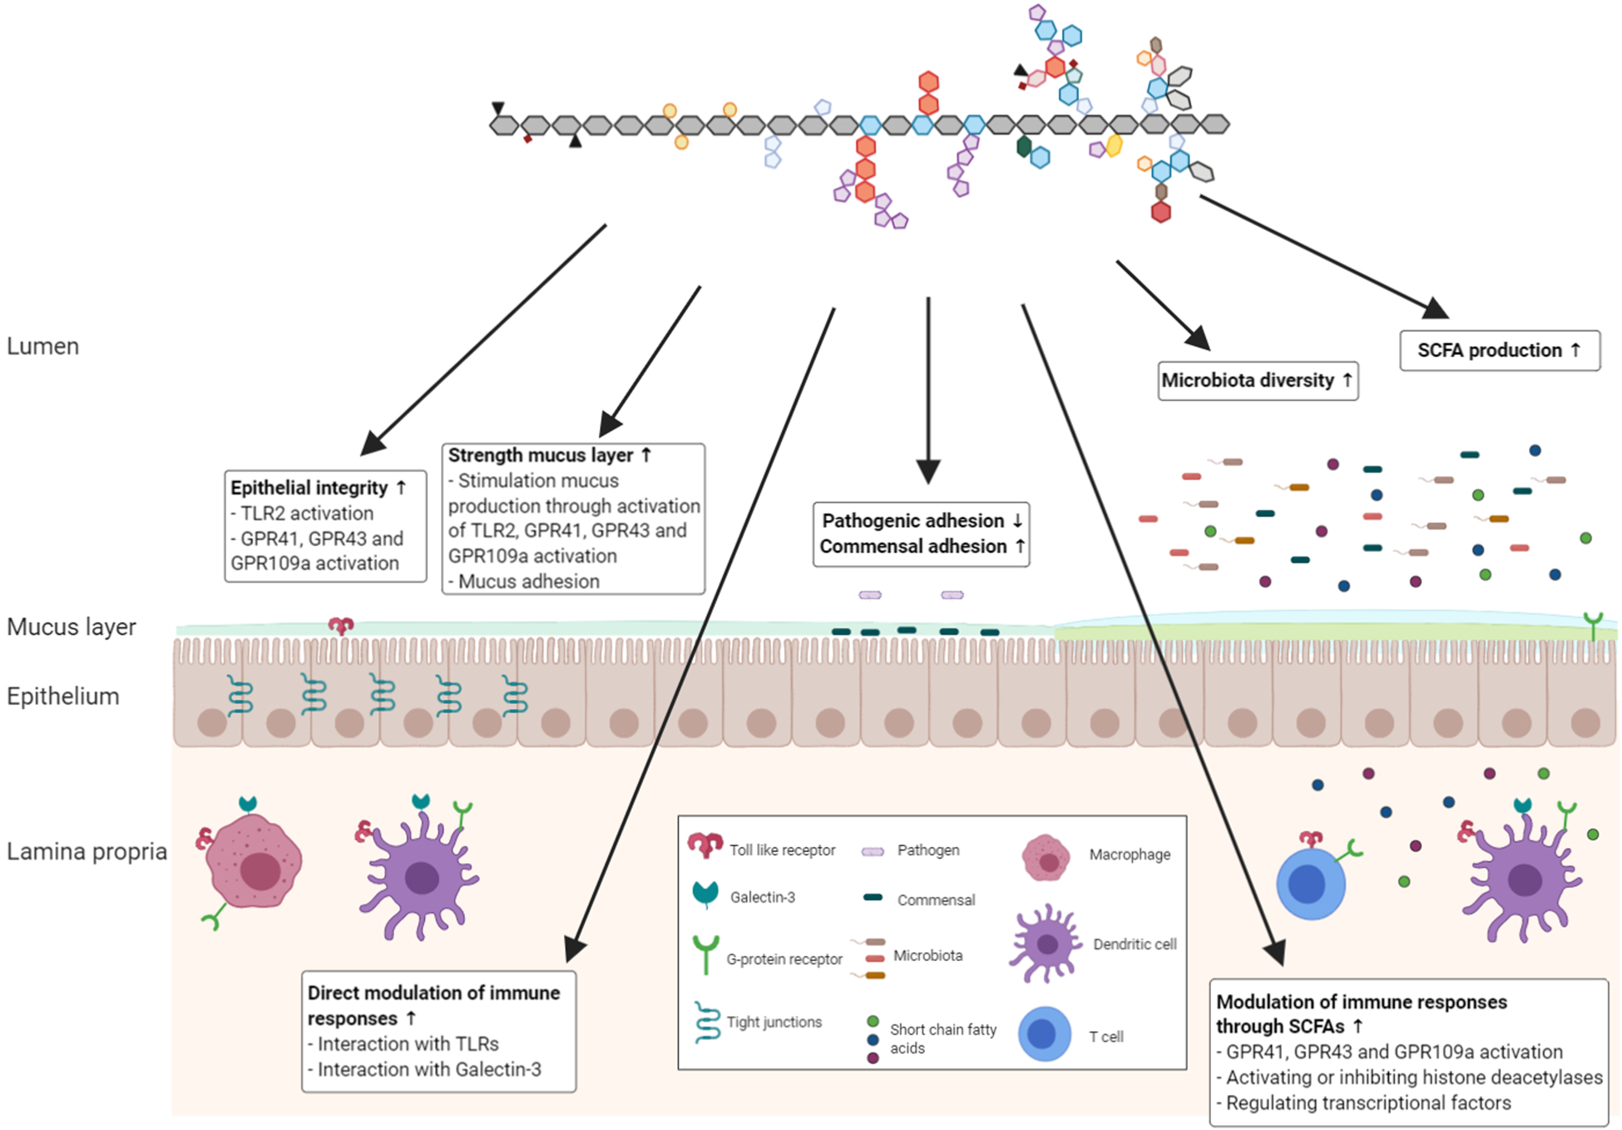
Fiber restores the gut
Beukema M, Faas MM, de Vos P. The effects of different dietary fiber pectin structures on the gastrointestinal immune barrier: impact via gut microbiota and direct effects on immune cells. Exp Mol Med. 2020 Sep;52(9):1364-1376. doi: 10.1038/s12276-020-0449-2. Epub 2020 Sep 10. PMID: 32908213; PMCID: PMC8080816. This is an open access article under the CC BY license (http://creativecommons.org/licenses/by/4.0/). No changes made.

Slide 22
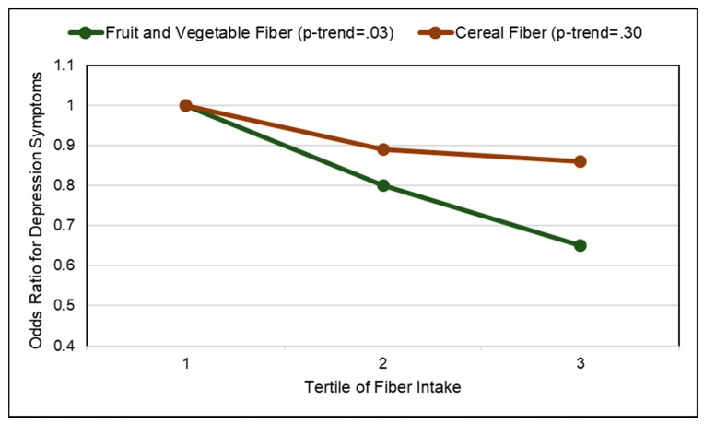
Depressive symptoms reduce with increasing dietary fiber
Image Credit : Dreher ML. Whole Fruits and Fruit Fiber Emerging Health Effects. Nutrients. 2018;10(12):1833. Published 2018 Nov 28. doi:10.3390/nu10121833. http://creativecommons.org/licenses/by/4.0/. No changes made.

Slide 23
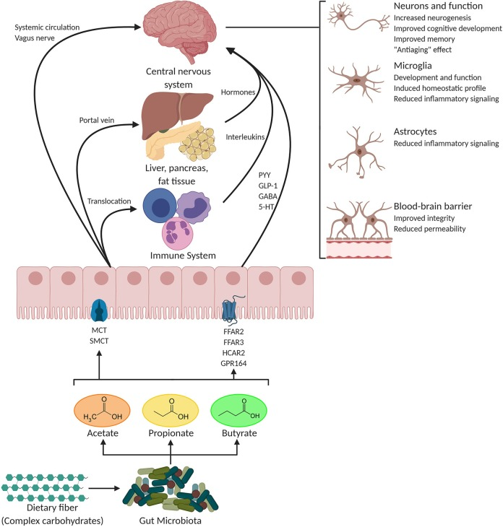
The food-gut-mood-brain axis:
The foods we take in become signaling agents for the brain
“The gut-brain axis [GBA] is a bidirectional information regulatory pathway composed of the central nervous system (CNS), neuroendocrine system, neuroimmune system, autonomic nervous system and enteric nervous system.”
Quote reference: Liu, S.; Cheng, L.; Liu, Y.; Zhan, S.; Wu, Z.; Zhang, X. Relationship between Dietary Polyphenols and Gut Microbiota: New Clues to Improve Cognitive Disorders, Mood Disorders and Circadian Rhythms. Foods 2023, 12, 1309. https://doi.org/10.3390/foods12061309
Image Credit: Silva YP, Bernardi A, Frozza RL. The Role of Short-Chain Fatty Acids From Gut Microbiota in Gut-Brain Communication. Front Endocrinol (Lausanne). 2020;11:25. Published 2020 Jan 31. doi:10.3389/fendo.2020.00025. Open access CC BY
Notes:
Copyright © 2020 Silva, Bernardi and Frozza.
This is an open-access article distributed under the terms of the Creative Commons Attribution License (CC BY). The use, distribution or reproduction in other forums is permitted, provided the original author(s) and the copyright owner(s) are credited and that the original publication in this journal is cited, in accordance with accepted academic practice. No use, distribution or reproduction is permitted which does not comply with these terms.

Slide 24
Short-chain fatty acids (SCFAs) for the gut-brain axis
Stimulates the production of mucin
Helps to promote manufacture of antibacterial peptides and tight junction proteins
Provides energy source for colonocytes
Signals from gut through G-protein coupled receptors to affect gut and immune function
Reduce the production of cortisol
Enhances the production of BDNF
1. van der Merwe, M. (2021). Gut microbiome changes induced by a diet rich in fruits and vegetables. International Journal of Food Sciences and Nutrition, 72(5), 665–669. https://doi.org/10.1080/09637486.2020.1852537. 2. Dalile, B., Vervliet, B., et al. (2020). Colon-delivered short-chain fatty acids attenuate the cortisol response to psychosocial stress in healthy men: A randomized, placebo-controlled trial. Neuropsychopharmacology: Official Publication of the American College of Neuropsychopharmacology, 45(13), 2257–2266. https://doi.org/10.1038/s41386-020-0732-x. 3. van de Wouw, M., Boehme, et al. (2018). Short-chain fatty acids: Microbial metabolites that alleviate stress-induced brain-gut axis alterations. The Journal of Physiology, 596(20), 4923–4944. https://doi.org/10.1113/JP276431. 4. Suda, K., & Matsuda, K. (2022). How microbes affect depression: Underlying mechanisms via the gut-brain axis and the modulating role of probiotics. International Journal of Molecular Sciences, 23(3), 1172. https://doi.org/10.3390/ijms23031172
Notes:
1. van der Merwe, M. (2021). Gut microbiome changes induced by a diet rich in fruits and vegetables. International Journal of Food Sciences and Nutrition, 72(5), 665–669. https://doi.org/10.1080/09637486.2020.1852537. PMID: 33960869
2. Dalile, B., Vervliet, B., et al. (2020). Colon-delivered short-chain fatty acids attenuate the cortisol response to psychosocial stress in healthy men: A randomized, placebo-controlled trial. Neuropsychopharmacology: Official Publication of the American College of Neuropsychopharmacology, 45(13), 2257–2266. https://doi.org/10.1038/s41386-020-0732-x. PMID: 32521538
3. van de Wouw, M., Boehme, et al. (2018). Short-chain fatty acids: Microbial metabolites that alleviate stress-induced brain-gut axis alterations. The Journal of Physiology, 596(20), 4923–4944. https://doi.org/10.1113/JP276431. PMID: 30066368
4. Suda, K., & Matsuda, K. (2022). How microbes affect depression: Underlying mechanisms via the gut-brain axis and the modulating role of probiotics. International Journal of Molecular Sciences, 23(3), 1172. https://doi.org/10.3390/ijms23031172. PMID: 35163104

Slide 25
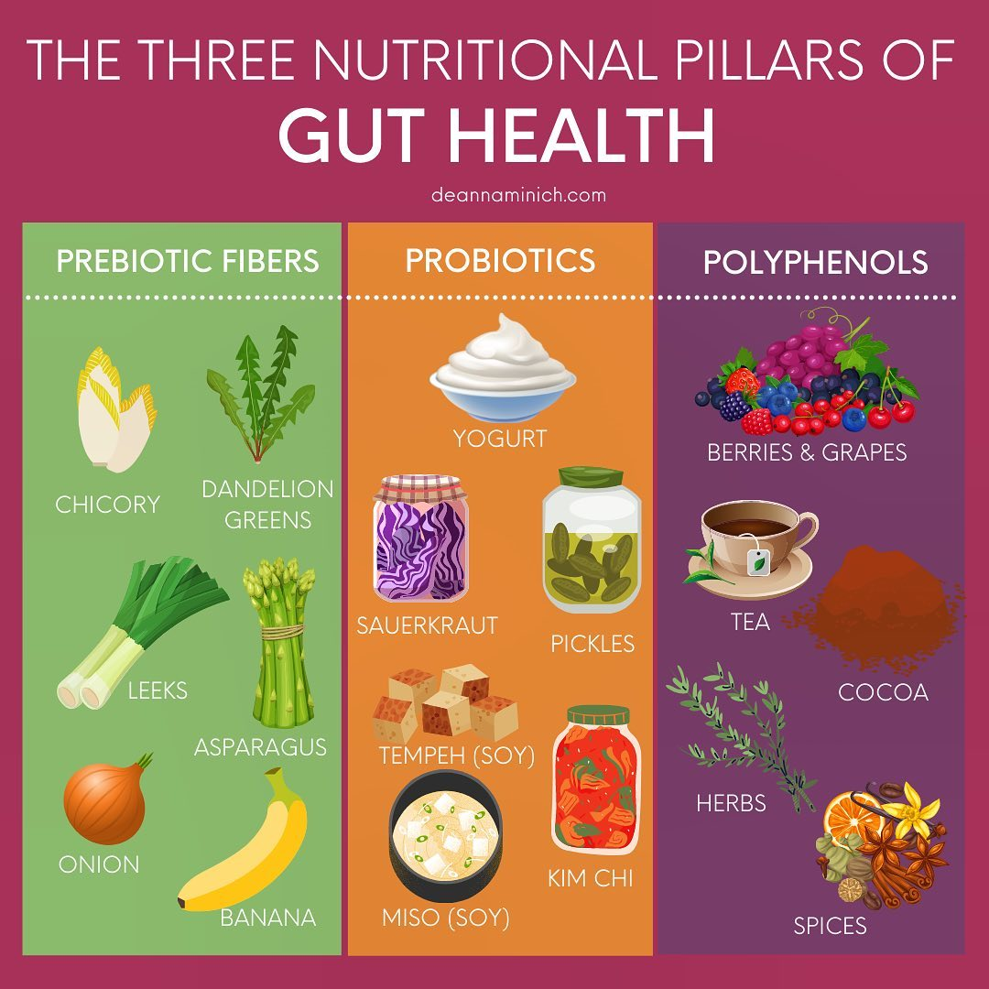
The 3P Approach to Gut Health:
Prebiotics, Probiotics, and Polyphenols

Slide 26
Nutrient Imbalance
Lacking cofactors for neurotransmission
Unhealthy diets (brown, yellow, white)
Lack of omega-3 fatty acids
Lack of proper macronutrient quantity and quality for energy and neurotransmitter balance
Lack of vitamins (vitamin C, D, B6, B9, B12, etc.)
Lack of minerals (Mg, Zn, Fe, Se)
Lack of phytonutrients for harmonizing cellular activities, hormone/neurotransmitter agonists
LaChance, L. R., & Ramsey, D. (2018). Antidepressant foods: An evidence-based nutrient profiling system for depression. World Journal of Psychiatry, 8(3), 97–104. https://doi.org/10.5498/wjp.v8.i3.97

Slide 27
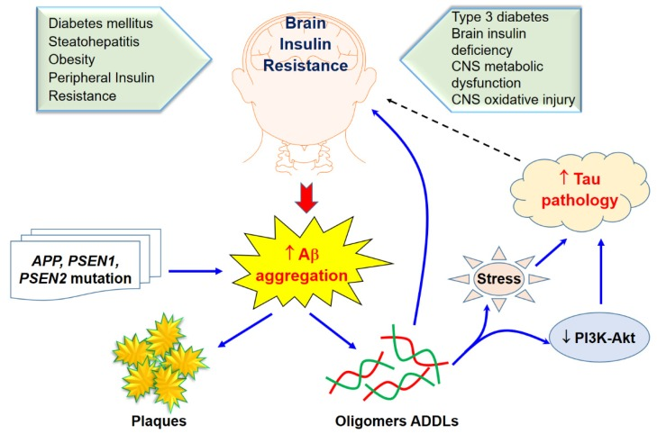
Type 3 Diabetes:
The interface between insulin & amyloid
Nguyen TT, Ta QTH, Nguyen TKO, Nguyen TTD, Giau VV. Type 3 Diabetes and Its Role Implications in Alzheimer's Disease. Int J Mol Sci. 2020 Apr 30;21(9):3165. doi: 10.3390/ijms21093165. PMID: 32365816; PMCID: PMC7246646. Open access CC-BY 4.0.
Notes:
Copyright © 2020 by the authors.
Licensee MDPI, Basel, Switzerland. This article is an open access article distributed under the terms and conditions of the Creative Commons Attribution (CC BY) license (http://creativecommons.org/licenses/by/4.0/).

Slide 28
Poor nutritional quality diets and increased risk of depression
More studies indicating a relationship between food and mood
Greater risk for depression with:
  Fast food intake¹
  Ultraprocessed foods²
  Higher added sugars & lower quality of carbohydrate³
1. Sánchez-Villegas, A., et al. (2012). Fast-food and commercial baked goods consumption and the risk of depression. Public Health Nutrition, 15(3), 424–432. https://doi.org/10.1017/S1368980011001856 PMID: 21835082; 2. Gómez-Donoso, C., et al. (2020). Ultra-processed food consumption and the incidence of depression in a Mediterranean cohort: The SUN Project. European Journal of Nutrition, 59(3), 1093–1103. https://doi.org/10.1007/s00394-019-01970-1 PMID: 31055621; 3. Sanchez-Villegas, A., et al. (2018). Added sugars and sugar-sweetened beverage consumption, dietary carbohydrate index and depression risk in the Seguimiento Universidad de Navarra (SUN) Project. The British Journal of Nutrition, 119(2), 211–221. https://doi.org/10.1017/S0007114517003361 PMID: 29268815

Slide 29
12 Nutrients for Better Mood
Folate
Iron
Omega-3 fatty acids
Magnesium
Potassium
Selenium
Thiamin (vitamin B₁)
Vitamin A
Vitamin B₆
Vitamin B₁₂
Vitamin C
Zinc
LaChance LR, Ramsey D. Antidepressant foods: An evidence-based nutrient profiling system for depression. World J Psychiatry. 2018 Sep 20;8(3):97-104. doi: 10.5498/wjp.v8.i3.97. PMID: 30254980; PMCID: PMC6147775.

Slide 30
Antidepressant foods from greatest to least score
Vegetables
Organ meats
Fruits
Seafood
Legumes
Meats
Grains
Nuts and seeds
Dairy
LaChance LR, Ramsey D. Antidepressant foods: An evidence-based nutrient profiling system for depression. World J Psychiatr 2018; 8(3): 97-104 Available from: URL: http://www.wjgnet.com/2220-3206/full/v8/i3/97.htm DOI: http://dx.doi.org/10.5498/wjp.v8.i3.97

Slide 31
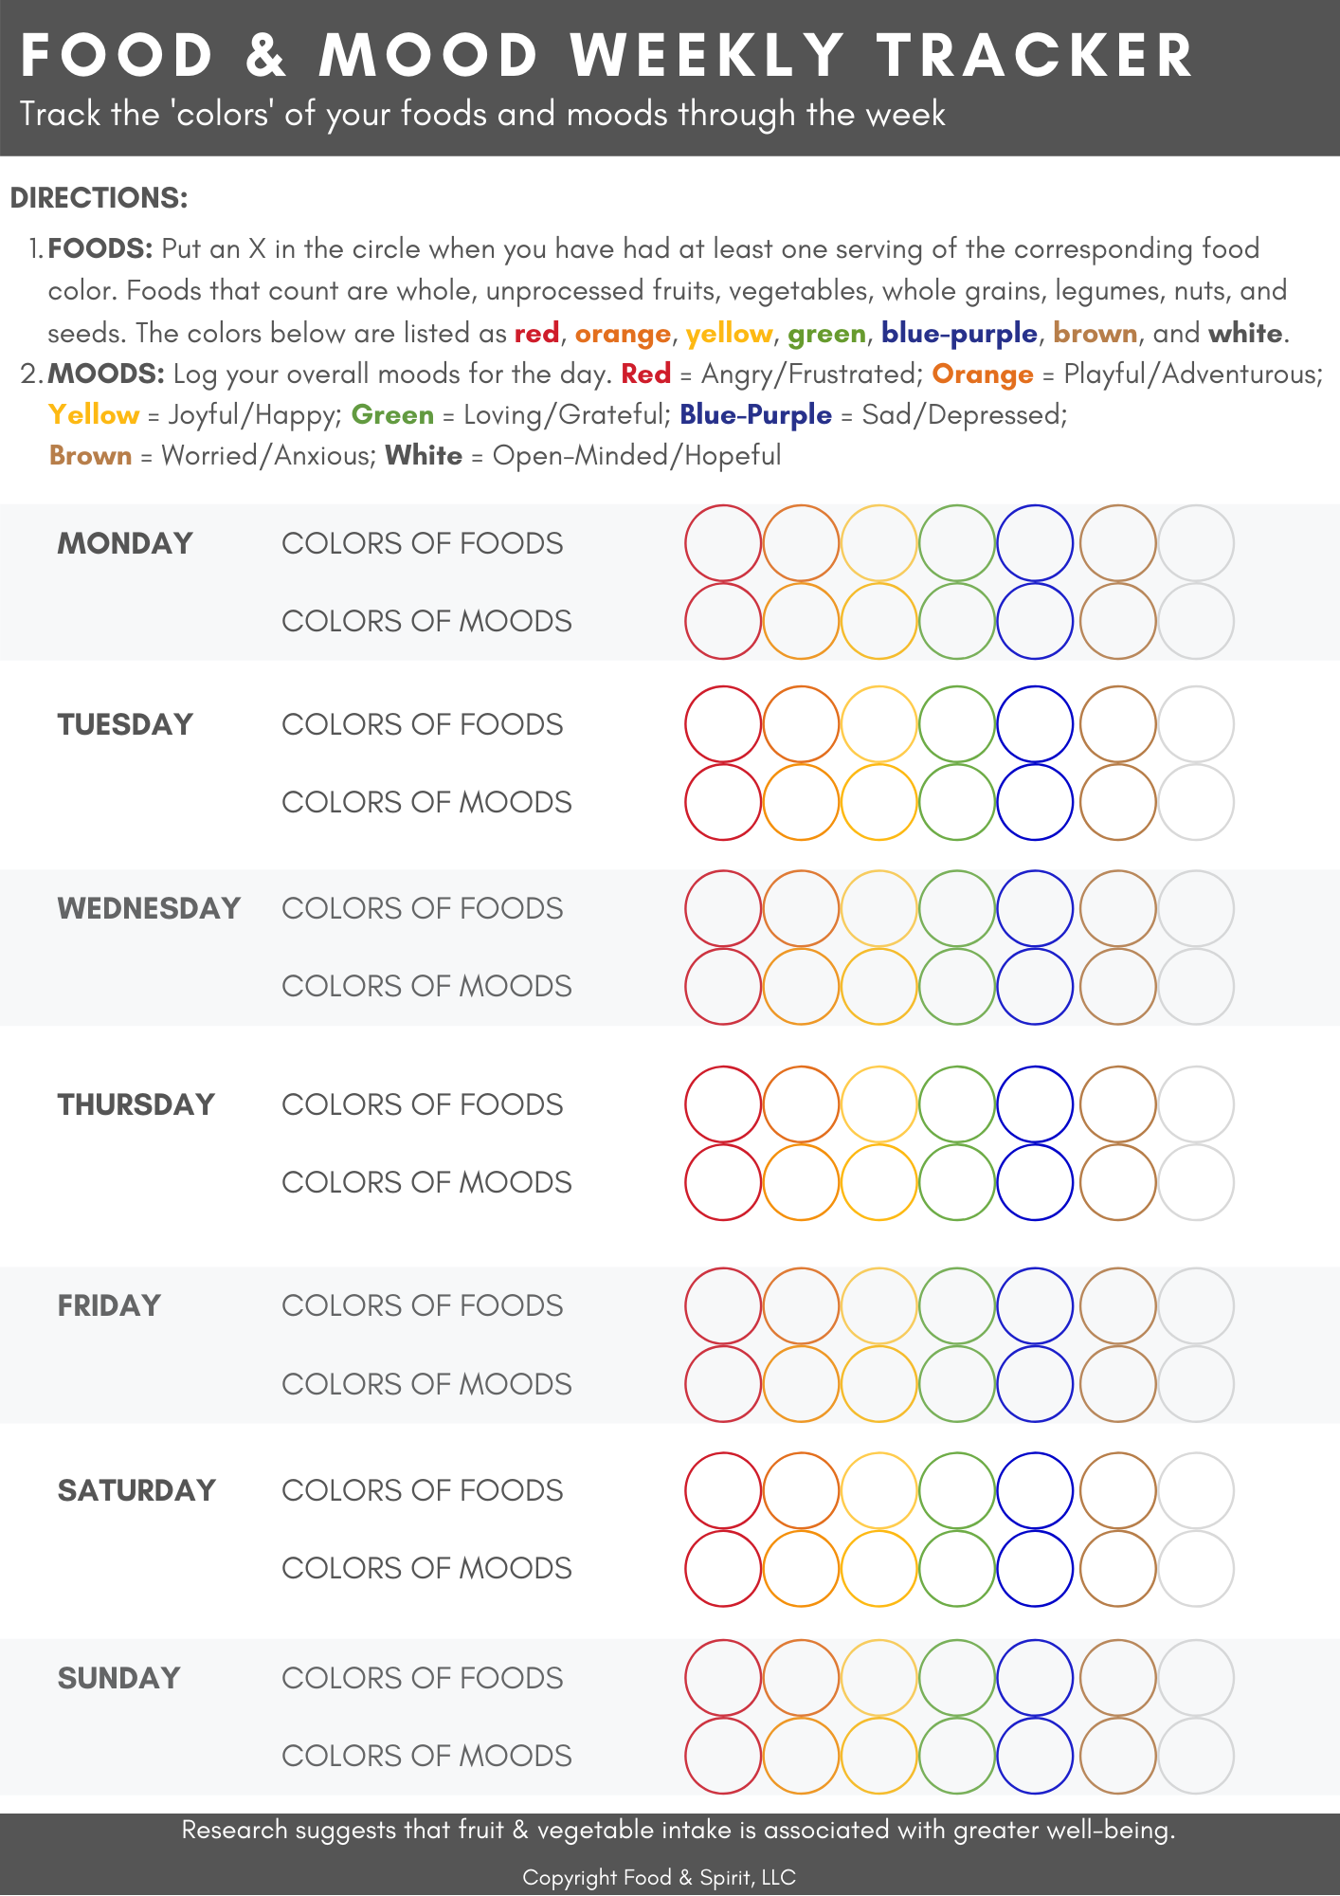

FOOD & MOOD
WEEKLY TRACKER
Identifying correlations between colors of foods and colors of moods

Slide 32
Tracking emotional patterns
Difficulty identifying and making sense of emotional states and not knowing how to regulate emotions are implicated in the relationship between emotions and binge eating. ¹
Be specific as to what you are feeling
Identify “little and important hurts”
Record what makes you feel strongly for 2 months
Keep a journal
HRV biofeedback device
1. Whiteside U, Chen E, Neighbors C, Hunter D, Lo T, Larimer M. Difficulties regulating emotions: Do binge eaters have fewer strategies to modulate and tolerate negative affect? Eat Behav. 2007 Apr;8(2):162-9. Epub 2006 May 22

Slide 33
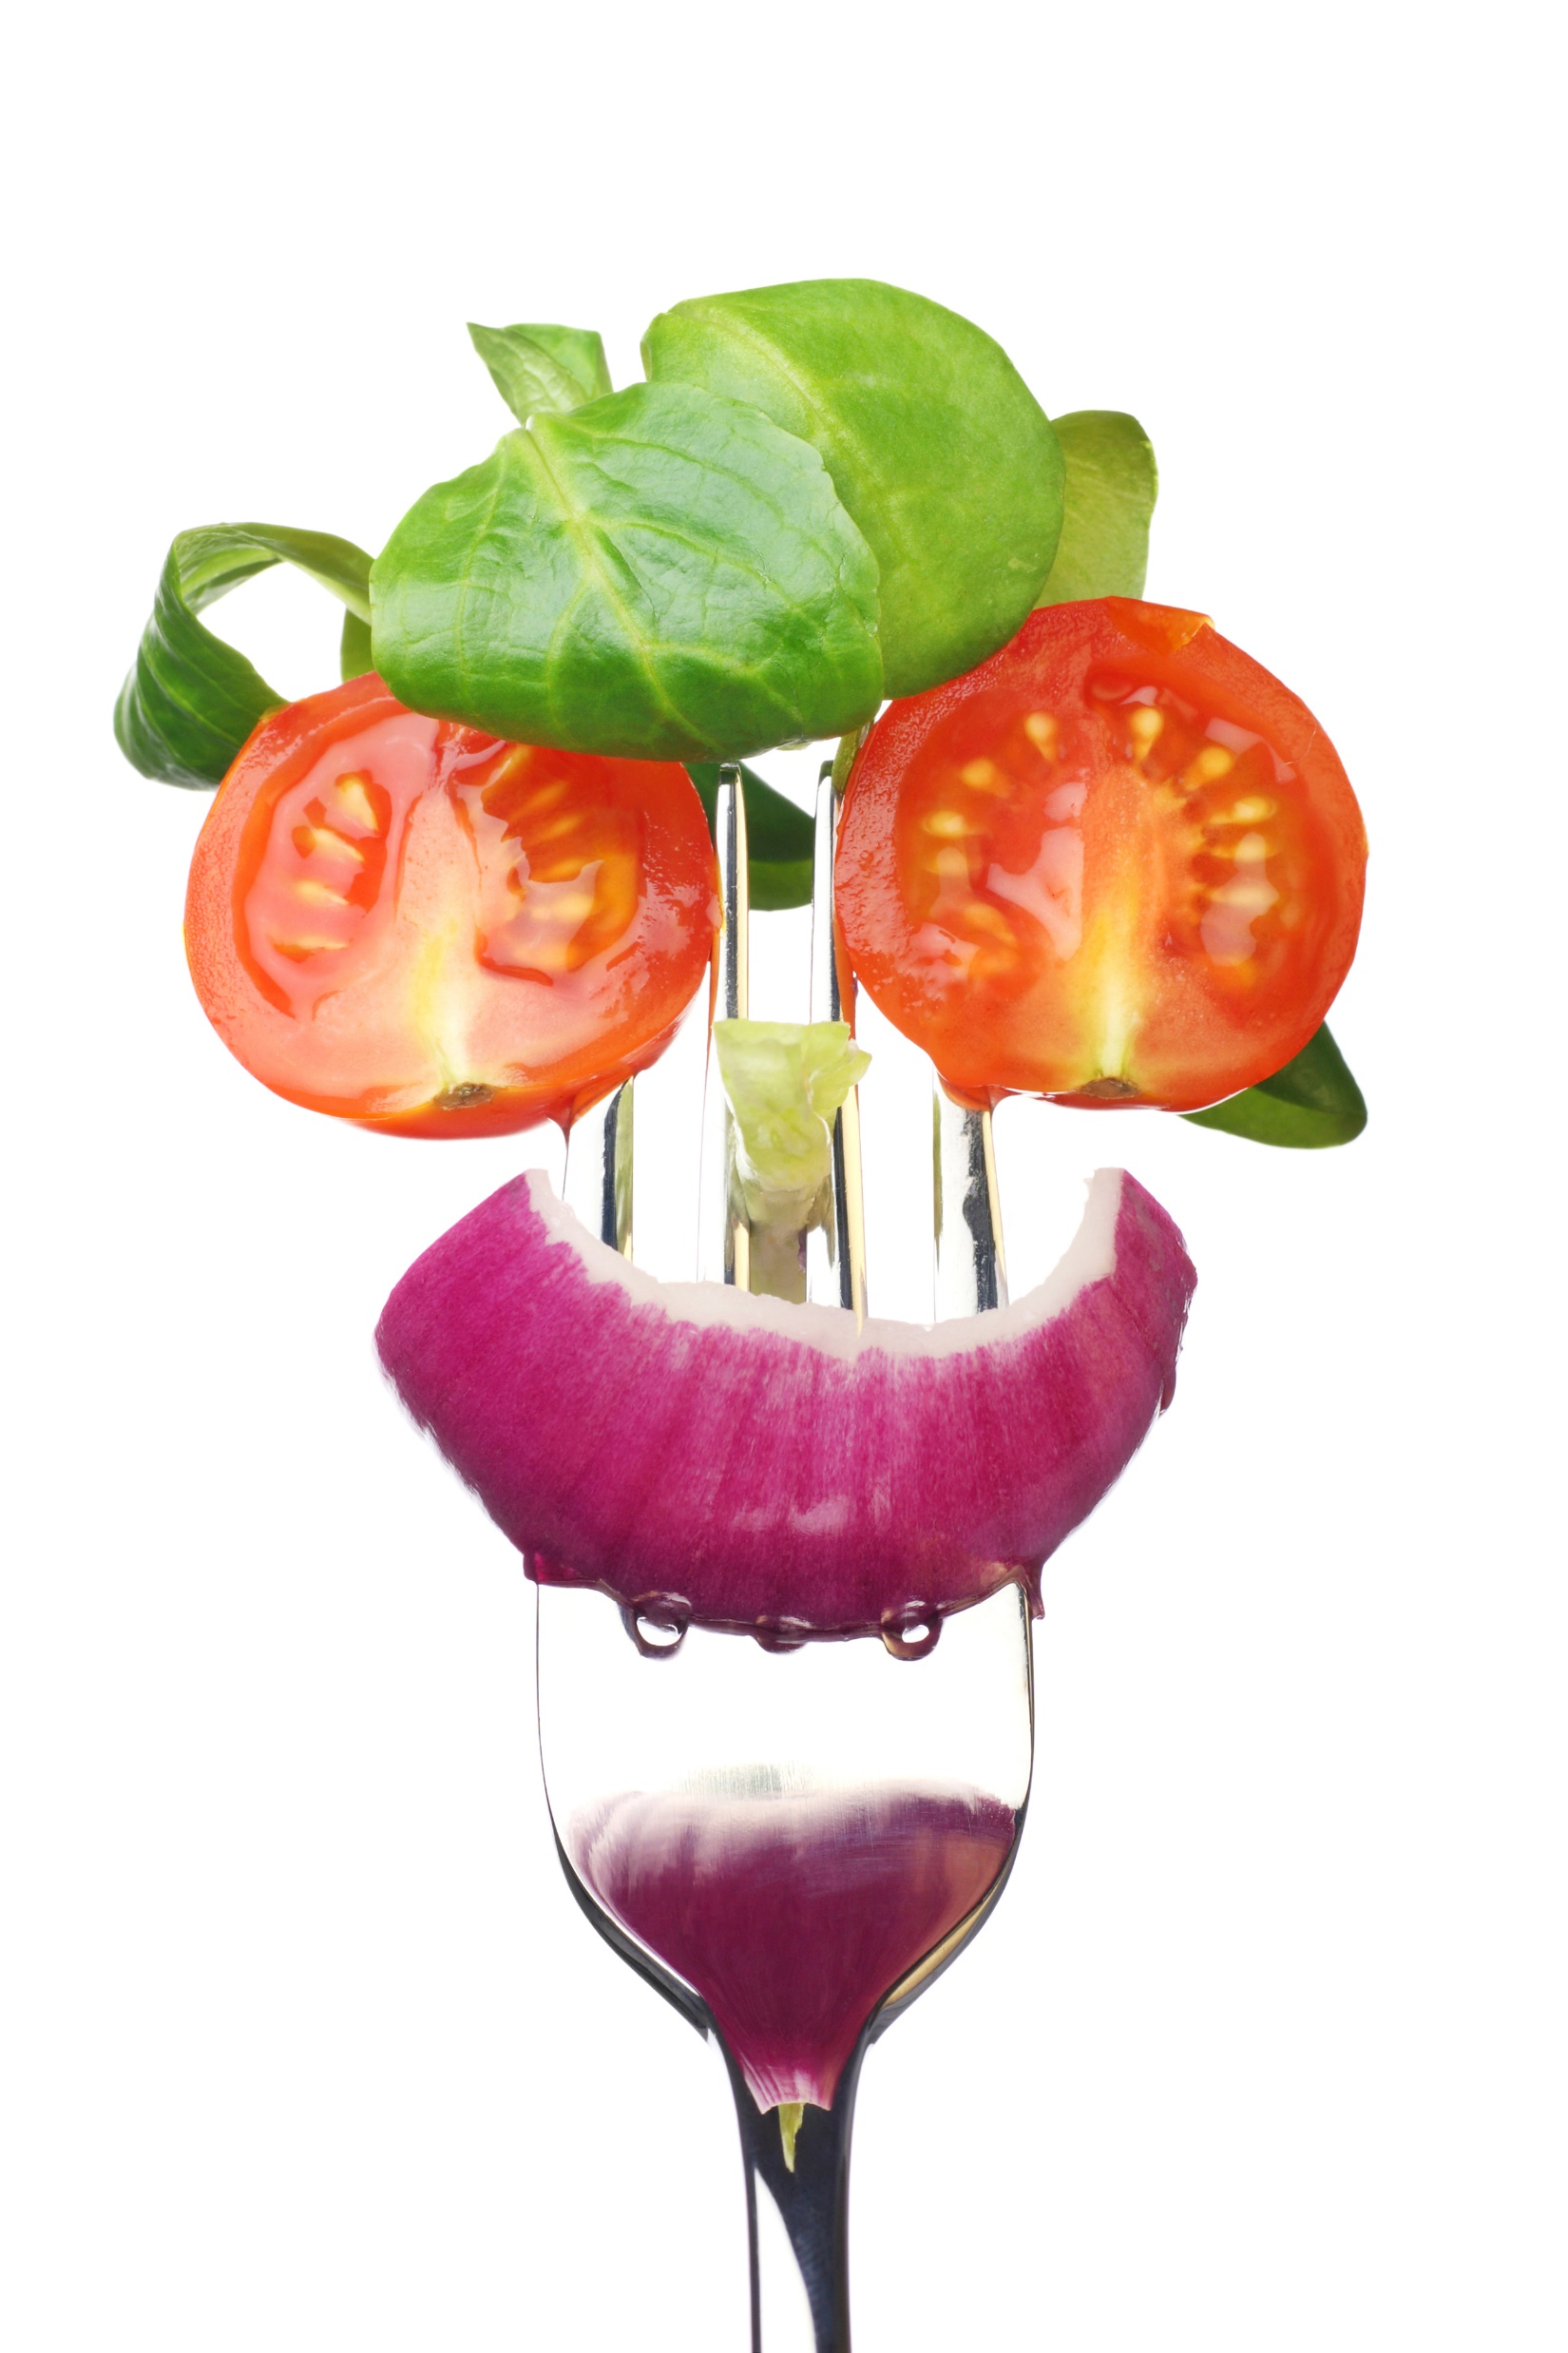
Colorful foods make for colorful moods!

Slide 34
Lifestyle aspects related to brain inflammation
Sleep-food-brain connection

Slide 35
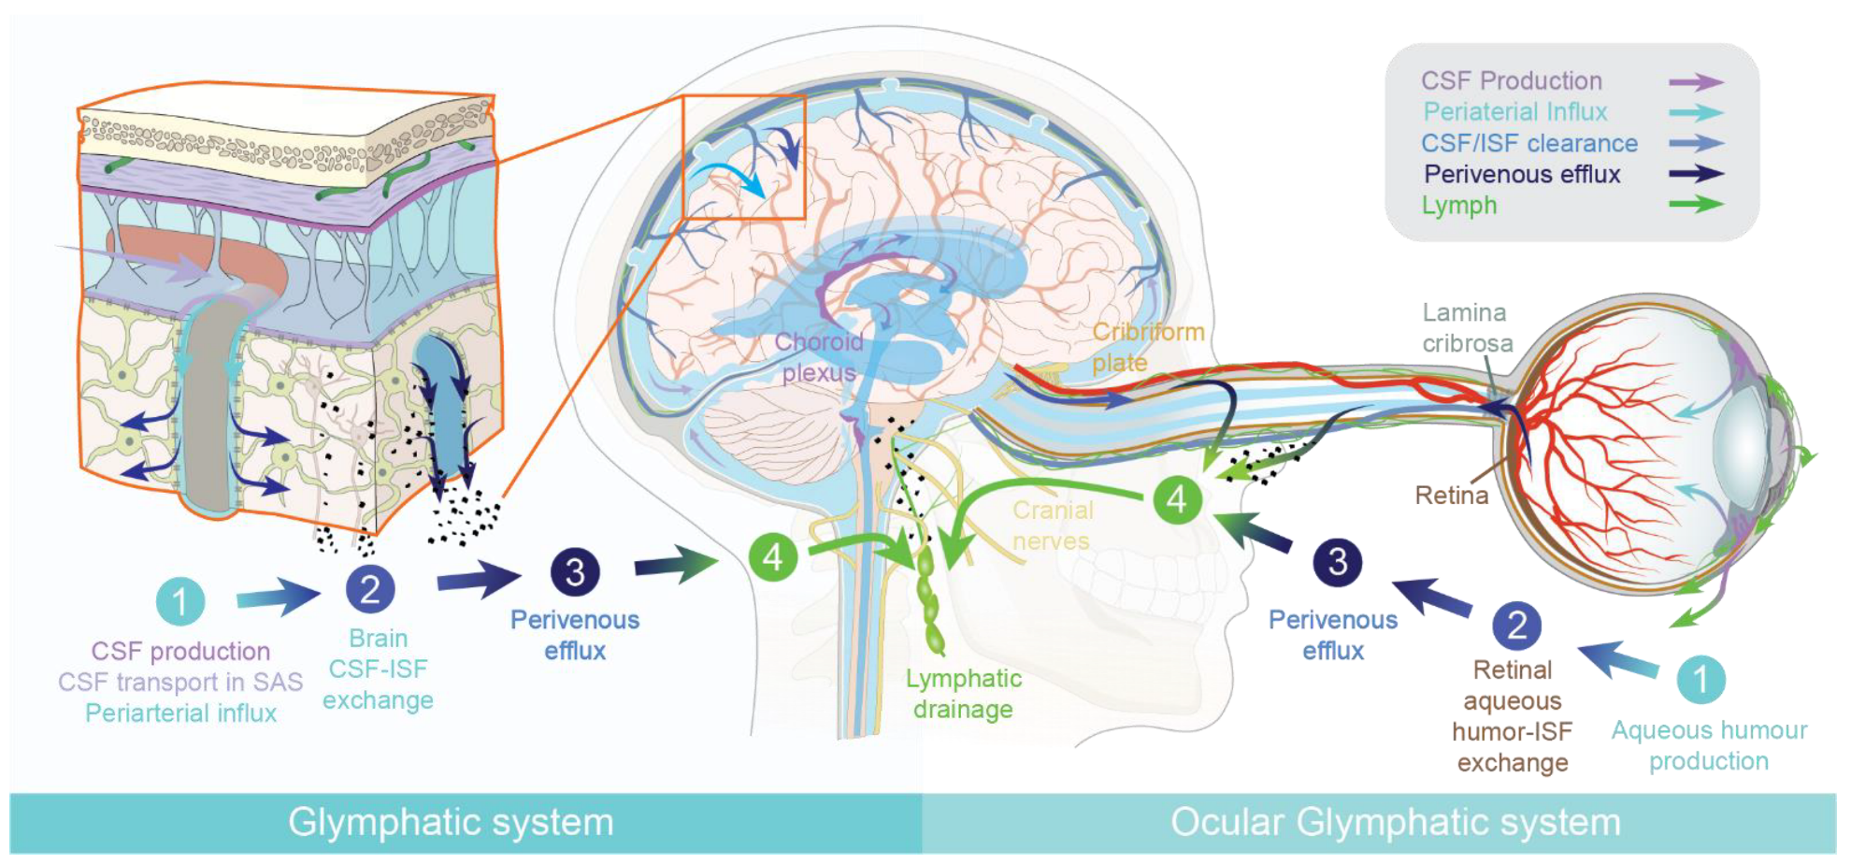
The brain detoxifies during sleep
Image Credit: Mogensen, F.L.-H.; Delle, C.; Nedergaard, M. The Glymphatic System (En)during Inflammation. Int. J. Mol. Sci. 2021, 22, 7491. https://doi.org/10.3390/ijms22147491. This article is an open access article distributed under the terms and conditions of the Creative Commons Attribution license. CC-BY 4.0.
Notes:
© 2021 by the authors. Licensee MDPI, Basel, Switzerland. This article is an open access article distributed under the terms and conditions of the Creative Commons Attribution (CC BY) license (https://creativecommons.org/licenses/by/4.0/).

Slide 36
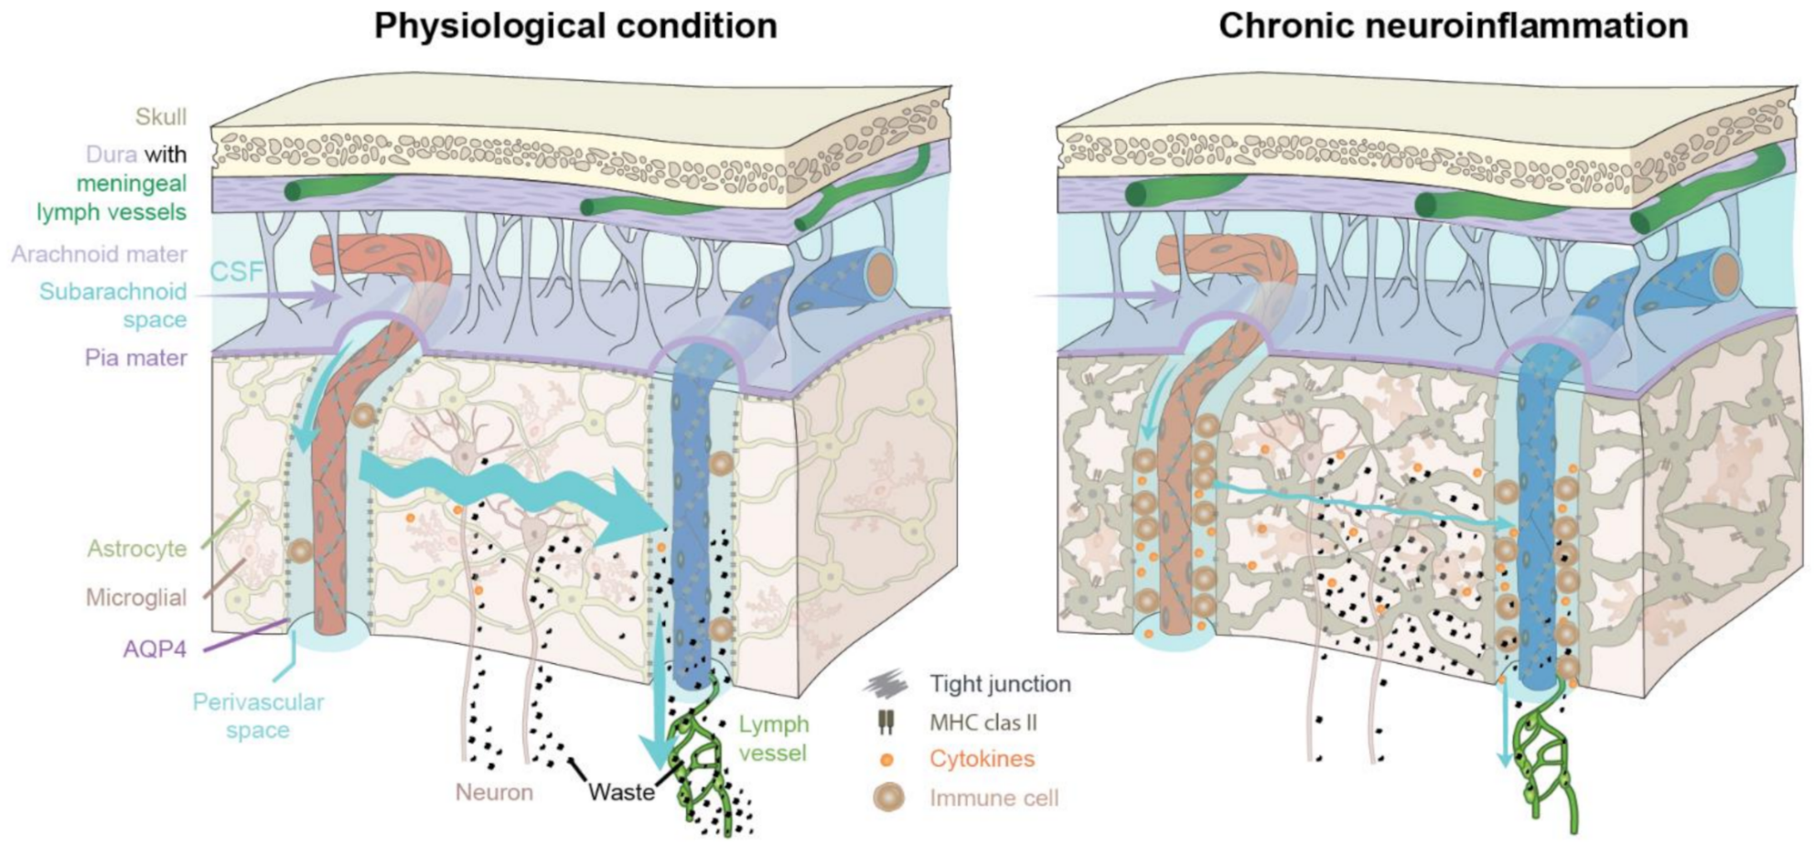
Inflammation impedes glymphatic function and flux
Image Credit: Mogensen, F.L.-H.; Delle, C.; Nedergaard, M. The Glymphatic System (En)during Inflammation. Int. J. Mol. Sci. 2021, 22, 7491. https://doi.org/10.3390/ijms22147491. This article is an open access article distributed under the terms and conditions of the Creative Commons Attribution license. CC-BY 4.0
Notes:
© 2021 by the authors. Licensee MDPI, Basel, Switzerland. This article is an open access article distributed under the terms and conditions of the Creative Commons Attribution (CC BY) license (https://creativecommons.org/licenses/by/4.0/).

Slide 37
Lifestyle strategies for optimizing clearance of toxic metabolites during sleep
Omega-3 fatty acid supplementation may improve glymphatic clearance and reduces beta-amyloid buildup [1].
Intermittent fasting: Fasting one day and eating ad lib the next may help reduce beta-amyloid deposition [1].
Intermediate and heavy alcohol intake reduces glymphatic transport [1].
Physical activity (aim for 150 min moderate activity weekly) may accelerate glymphatic clearance [1].
Stress management to help with reducing cortisol and subsequent amyloid buildup [1]
Body posture may be part of the process.
  Lateral position preferred over supine [2].
  Right lateral position most preferred [1].
1. Reddy, O. C., & van der Werf, Y. D. (2020). The Sleeping Brain: Harnessing the Power of the Glymphatic System through Lifestyle Choices. Brain Sciences, 10(11), 868. https://doi.org/10.3390/brainsci10110868 PMID: 33212927; 2. Lee, H., Xie, L., Yu, M., Kang, H., Feng, T., et al. (2015). The Effect of Body Posture on Brain Glymphatic Transport. The Journal of Neuroscience: The Official Journal of the Society for Neuroscience, 35(31), 11034–11044. https://doi.org/10.1523/JNEUROSCI.1625-15.2015 PMID: 26245965

Slide 38


GUIDELINES: Brain Health
Tend to inflammation:
Anti-inflammatory diet
Emphasis on blue-purple foods
Stress management
Adequate sleep
Nourish the gut microbiome:
Dietary fiber
Fiber supplements
Pre- and pro-biotics
Polyphenols (plant foods)
Balance nutrients:
Omega-3 fatty acids
Vitamins (B vitamins, C)
Sufficient protein
Minerals (zinc, iron)
Cultivate emotional health:
Eating timeline
Creative outlets
Food & mood tracker

Slide 39
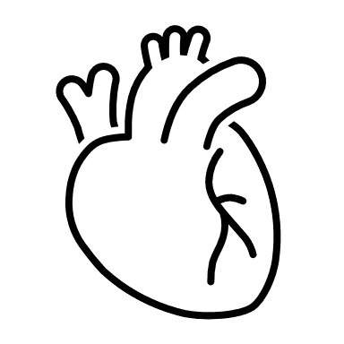
Clinical Conditions
Mind-Body Medicine
Abnormal blood pressure
Abnormal heart rate
Abnormal blood lipids
Angina
Arrhythmia
Atherosclerosis
Breathlessness
Fatigue
Poor circulation
Heart
Breath, Circulation, Oxygenation

Slide 40
Mind-Body Medicine
Select Root Causes to Address:
Inflammation
Autonomic nervous system balance
Nutrient imbalances
Heart
Breath, Circulation, Oxygenation

Slide 41
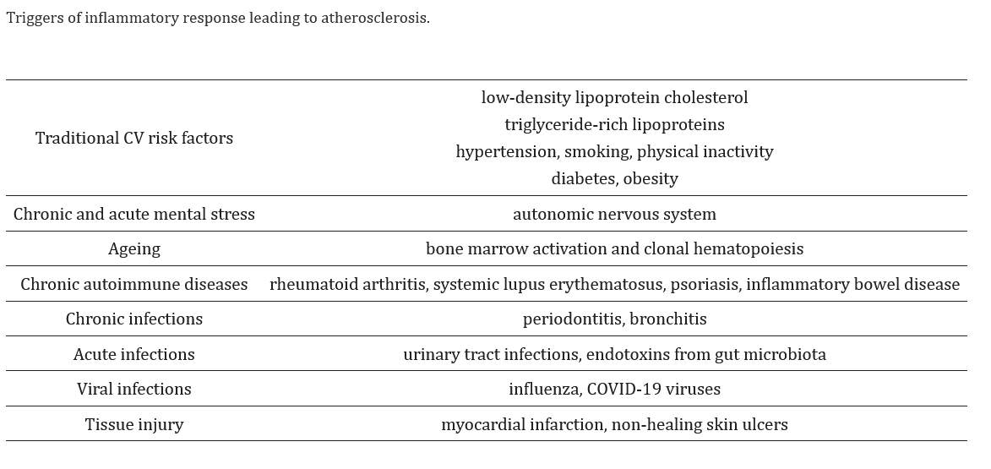
Inflammation
“Heart on Fire”
Henein MY, Vancheri S, Longo G, Vancheri F. The Role of Inflammation in Cardiovascular Disease. Int J Mol Sci. 2022 Oct 26;23(21):12906. doi: 10.3390/ijms232112906. PMID: 36361701; PMCID: PMC9658900. CC-BY 4.0
Notes:
Heightened stress response
Increased blood lipids
High homocysteine
Copyright © 2022 by the authors.
Licensee MDPI, Basel, Switzerland. This article is an open access article distributed under the terms and conditions of the Creative Commons Attribution (CC BY) license (https://creativecommons.org/licenses/by/4.0/).

Slide 42
“Inflammaging”
“Coagulaging”
Silent inflammation
Low, chronic inflammation with age
  Metabolic endotoxemia
  Low-level infectious load
  Latent infections
  Dysbiosis (gut health)
  Low nutrient reserves
InformedHealth.org [Internet]. Cologne, Germany: Institute for Quality and Efficiency in Health Care (IQWiG); 2006-. What happens when you age? 2020 Sep 10. https://www.ncbi.nlm.nih.gov/books/NBK279298/; Xu, K., Wei, Y., Giunta, S., Zhou, M., & Xia, S. (2021). Do inflammaging and coagul-aging play a role as conditions contributing to the co-occurrence of the severe hyper-inflammatory state and deadly coagulopathy during COVID-19 in older people?. Experimental Gerontology, 151, 111423. https://doi.org/10.1016/j.exger.2021.111423; Sebastian-Valverde M, Pasinetti GM. The NLRP3 Inflammasome as a Critical Actor in the Inflammaging Process. Cells. 2020;9(6):1552. Published 2020 Jun 26. doi:10.3390/cells9061552

Slide 43
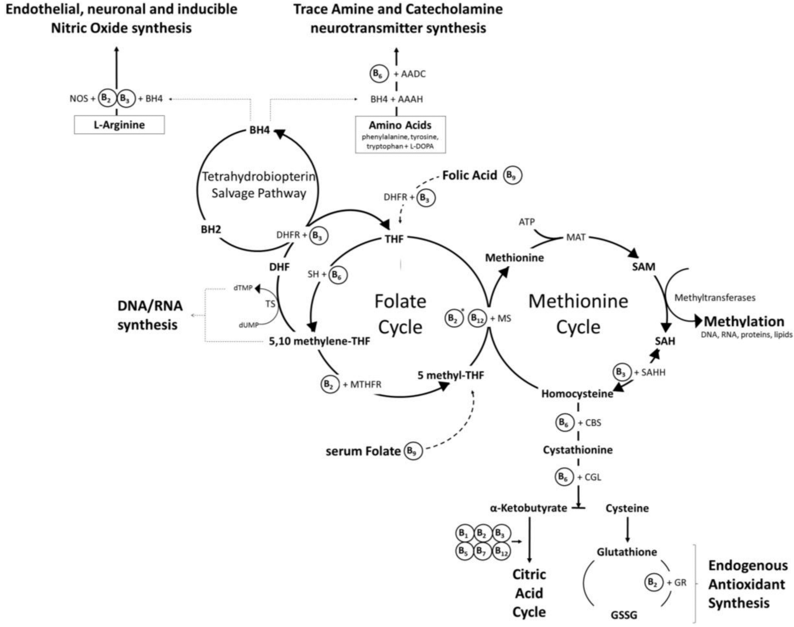
Homocysteine
Pizzorno J. Homocysteine: Friend or Foe? Integr Med (Encinitas). 2014 Aug;13(4):8-14. PMID: 26770102; PMCID: PMC4566450.
Image credit: Kennedy DO. B Vitamins and the Brain: Mechanisms, Dose and Efficacy—A Review. Nutrients. 2016, 8, 68. https://doi.org/10.3390/nu8020068. This is an open access article distributed under the Creative Commons Attribution License which permits unrestricted use, distribution, and reproduction in any medium, provided the original work is properly cited. No changes made.
Notes:
Hodges RE, Minich DM. Modulation of metabolic detoxification pathways using foods and food-derived components: A scientific review with clinical application. 2015. Journal of Nutrition and Metabolism. Article ID 760689. http://dx.doi.org/10.1155/2015/760689
__________________________________
Copyright at Hindawi
Copyright © 2015 Romilly E. Hodges and Deanna M. Minich. This is an open access article distributed under the Creative Commons Attribution License, which permits unrestricted use, distribution, and reproduction in any medium, provided the original work is properly cited.
All Hindawi journals are published Open Access. This means all articles are immediately available free-of-charge upon publication. Articles in Hindawi journals can be downloaded, shared, and reused without restriction, as long as the original authors are properly cited.
For the vast majority of articles in Hindawi journals, you do not need to seek permission from Hindawi for reuse. The copyright of most articles remains with the authors, who have chosen to make the articles available for reuse under an open license, such as the Creative Commons Attribution License (CC-BY). These licenses permit reuse and adaptation, as long as the original authors are cited. The applicable license for all articles is included in the front matter of the article in human- and machine-readable formats.
Rarely, Hindawi journals will contain material republished with permission under a more restrictive license. Where applicable, this will be clearly marked. In these cases, you may need to seek permission for reuse from the copyright holder.

Slide 44
Autonomic Nervous System Imbalance
“Sympathetic overdrive”
Sympathetic nervous system excess
Vagus nerve dysfunction
Reduced heart rate variability
Increased heart rate, pulse, body temperature

Slide 45
Short-term stress reactions
Physiological Effects of Stress
Long-term stress reactions
Increased heart rate and blood pressure
Increased metabolic rate: breakdown of glycogen to glucose for energy
Increased respiration: opening of bronchioles
Increased blood flow for increased alertness, reduced digestive activity, reduced urine production
Sharpened cognition
Increased need for energy through catabolism: mobilization of protein and fat for energy, gluconeogenesis for continued energy
Reduced insulin sensitivity
Reduced immune response
References: Guilliams TG. The role of stress and the HPA axis in chronic disease management. Point Institute, 2015; What Is Stress? by OSCRiceUniversity is licensed under a Creative Commons Attribution 4.0 International License, except where otherwise noted. https://opentext.wsu.edu/ospsychrevisions/chapter/what-is-stress/#CNX_Psych_14_01_FightFlight
Notes:
Gulliams -- Copyright © 2020 Point Institute
https://www.pointinstitute.org/product/the-role-of-stress-and-the-hpa-axis-in-chronic-disease-management/
Deanna, I see a copyright on the webpage but could not locate permission information on the website.

Slide 46
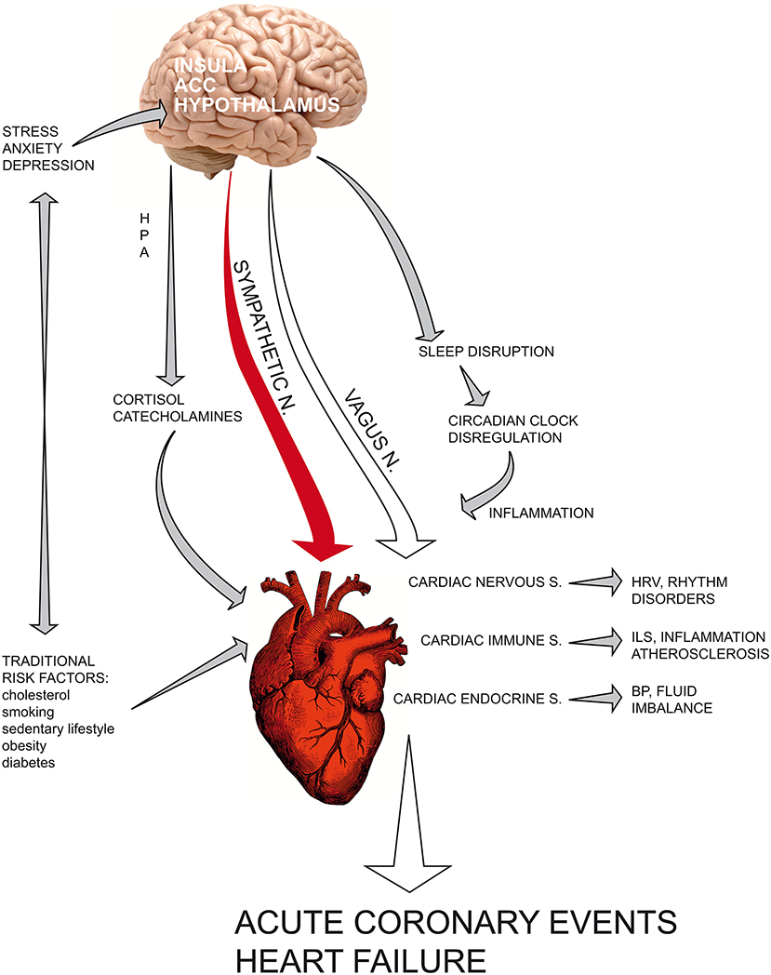
Stress is connected to heart disease.
“Psychological distress can precipitate heart function through a dysregulated neuroendocrine and autonomic response, as demonstrated by increased serum cortisol and catecholamines, reduced HRV and increased inflammatory cascades. Sympathetic hyperactivation can influence cytokine production via the transcription of NFkB-mediated genes involved in pro-inflammatory immune response, thus enhancing vascular endothelial activation and thrombosis.”
Quote and Image Credit: Fioranelli M, Bottaccioli AG, Bottaccioli F, Bianchi M, Rovesti M, Roccia MG. Stress and Inflammation in Coronary Artery Disease: A Review Psychoneuroendocrineimmunology-Based. Front Immunol. 2018;9:2031. Published 2018 Sep 6. doi:10.3389/fimmu.2018.02031. Open access CC BY.
Notes:
Copyright © 2018 Fioranelli, Bottaccioli, Bottaccioli, Bianchi, Rovesti and Roccia.
This is an open-access article distributed under the terms of the Creative Commons Attribution License (CC BY). The use, distribution or reproduction in other forums is permitted, provided the original author(s) and the copyright owner(s) are credited and that the original publication in this journal is cited, in accordance with accepted academic practice. No use, distribution or reproduction is permitted which does not comply with these terms.

Slide 47
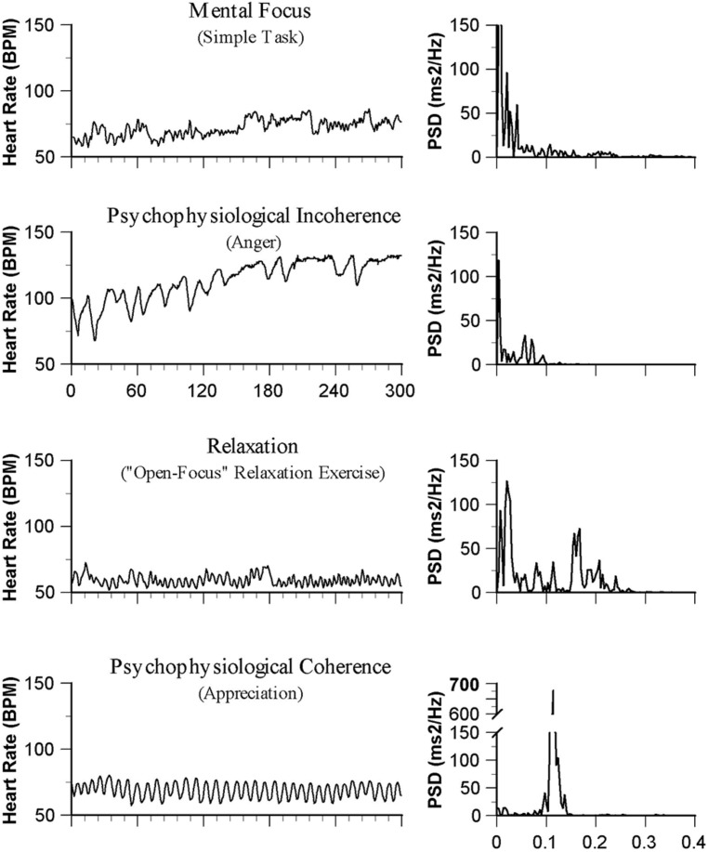
Emotions are reflected in the heart rate
Image Credit: McCraty R, Zayas MA. Cardiac coherence, self-regulation, autonomic stability, and psychosocial well-being. Front Psychol. 2014;5:1090. Published 2014 Sep 29. doi:10.3389/fpsyg.2014.01090. No changes. CC
Notes:
Copyright © 2014 McCraty and Zayas.
This is an open-access article distributed under the terms of the Creative Commons Attribution License (CC BY). The use, distribution or reproduction in other forums is permitted, provided the original author(s) or licensor are credited and that the original publication in this journal is cited, in accordance with accepted academic practice. No use, distribution or reproduction is permitted which does not comply with these terms. Attribution 4.0 International (CC BY 4.0)
You are free to:
Share — copy and redistribute the material in any medium or format
Adapt — remix, transform, and build upon the material for any purpose, even commercially.

Slide 48

Forest Therapy
(“Vitamin N”)
Enhanced positive mood and reduced negative mood
Blood pressure and heart rates decreased
Peripheral oxygen saturation increased
Corticosterone level in peripheral blood lymphocytes decreased
Lyu B, Zeng C, Xie S, et al. Benefits of A Three-Day Bamboo Forest Therapy Session on the Psychophysiology and Immune System Responses of Male College Students. Int J Environ Res Public Health. 2019;16(24):4991. Published 2019 Dec 8. doi:10.3390/ijerph16244991
Notes:
SS 287122835

Slide 49
Nutrient Imbalances
Hydration
Minerals such as magnesium
Methylation support
Dietary nitrates

Slide 50
Water
Functions | Multiple
Food Sources | Tap water, bottled water, fruits, juices, sauces, soups, teas, broths
Risk Factors | Older age, diarrhea, vomiting, laxative use, athletes, exposure to heat, those on diuretics, impaired access to water
Deficiency Symptoms | Cognitive impairment, fatigue, thirst, dry skin and lips, dark urine or decreased urine output, headaches, muscle cramps, lightheadedness, dizziness, syncope, orthostatic hypotension, and palpitation
Assessment | Physical exam signs: dry mucosa, skin tenting, delayed capillary refill, or cracked lips; bioelectrical impedance analysis, urine specific gravity, the osmolality of urine, saliva, number of urine voids, and urine volume have been used.
RDA/AI for adults | IOM has established AI values as 3.7 L for men, 2.7 L for women
Other | Consider activity level, urination, medication use, fiber supplementation
Taylor K, Jones EB. Adult Dehydration. [Updated 2021 May 19]. In: StatPearls [Internet]. Treasure Island (FL): StatPearls Publishing; 2021 Jan-. Available from: https://www.ncbi.nlm.nih.gov/books/NBK555956/; https://www.nal.usda.gov/sites/default/files/fnic_uploads/water_full_report.pdf

Slide 51
Micronutrients:
Magnesium (Mg)
Functions | Role in hormone receptor binding, muscle contraction, neural activity, neurotransmitter release, vasomotor tone, cardiac excitability, glucose metabolism
Food Sources | Green leafy vegetables, fish, legumes, whole grains, seeds, dried fruits
Risk Factors | Inadequate intake, decreased renal absorption, decreased gastrointestinal (GI) absorption, those with malabsorptive/GI disorders, chronic diarrhea, medications (e.g., diuretics, PPIs, insulin), excessive alcohol, soft drinks, coffee intake; high zinc; aluminum exposure (reduces absorption), high physical activity, type 2 diabetes; high ultra-processed food intake, boiling cooking methods
Deficiency Symptoms | Early signs of Mg deficiency: weakness, loss of appetite, fatigue, nausea, and vomiting; Established Mg deficiency: muscle contractions and cramps, numbness, tingling, personality changes, coronary spasms, abnormal heart rhythms, seizures; Severe Mg deficiency: hypocalcemia, hypokalemia, due to disruptions in mineral homeostasis
Assessment | Symptoms, blood levels of Mg and Ca, although serum levels do not strongly correlate with total body Mg/tissue concentrations.
RDA/AI for adults | RDA is 310-420 mg, depending on age/gender; TUL is based on supplemental Mg in addition to dietary intake, 350 mg/day.
Other | Note connection to insulin resistance
Allen MJ, Sharma S. Magnesium. [Updated 2021 May 7]. In: StatPearls [Internet]. Treasure Island (FL): StatPearls Publishing; 2021 Jan-. Available from: https://www.ncbi.nlm.nih.gov/books/NBK519036/; Fiorentini D, et al. Magnesium: Biochemistry, Nutrition, Detection, and Social Impact of Diseases Linked to Its Deficiency. Nutrients. 2021 Mar 30;13(4):1136. doi: 10.3390/nu13041136. PMID: 33808247; PMCID: PMC8065437. Fiorentini D, et al. Magnesium: Biochemistry, Nutrition, Detection, and Social Impact of Diseases Linked to Its Deficiency. Nutrients. 2021 Mar 30;13(4):1136. doi: 10.3390/nu13041136. PMID: 33808247; PMCID: PMC8065437.
Notes:
Copyright © 2017 Gerry K. Schwalfenberg and Stephen J. Genuis.
This is an open access article distributed under the Creative Commons Attribution License, which permits unrestricted use, distribution, and reproduction in any medium, provided the original work is properly cited.
Allen MJ, Sharma S. Magnesium. [Updated 2021 May 7]. In: StatPearls [Internet]. Treasure Island (FL): StatPearls Publishing; 2021 Jan-. Available from: https://www.ncbi.nlm.nih.gov/books/NBK519036/; Fiorentini D, Cappadone C, Farruggia G, Prata C. Magnesium: Biochemistry, Nutrition, Detection, and Social Impact of Diseases Linked to Its Deficiency. Nutrients. 2021 Mar 30;13(4):1136. doi: 10.3390/nu13041136. PMID: 33808247; PMCID: PMC8065437. Fiorentini D, Cappadone C, Farruggia G, Prata C. Magnesium: Biochemistry, Nutrition, Detection, and Social Impact of Diseases Linked to Its Deficiency. Nutrients. 2021 Mar 30;13(4):1136. doi: 10.3390/nu13041136. PMID: 33808247; PMCID: PMC8065437.

Slide 52
Supporting methylation with food-based nutrients
Nutrients for healthy methylation:
B vitamins
Amino acids
Betaine
Magnesium
Image credit: Kennedy DO. B Vitamins and the Brain: Mechanisms, Dose and Efficacy—A Review. Nutrients. 2016, 8, 68. https://doi.org/10.3390/nu8020068. This is an open access article distributed under the Creative Commons Attribution License which permits unrestricted use, distribution, and reproduction in any medium, provided the original work is properly cited. No changes made.
Notes:
Hodges RE, Minich DM. Modulation of metabolic detoxification pathways using foods and food-derived components: A scientific review with clinical application. 2015. Journal of Nutrition and Metabolism. Article ID 760689. http://dx.doi.org/10.1155/2015/760689
__________________________________
Copyright at Hindawi
Copyright © 2015 Romilly E. Hodges and Deanna M. Minich. This is an open access article distributed under the Creative Commons Attribution License, which permits unrestricted use, distribution, and reproduction in any medium, provided the original work is properly cited.
All Hindawi journals are published Open Access. This means all articles are immediately available free-of-charge upon publication. Articles in Hindawi journals can be downloaded, shared, and reused without restriction, as long as the original authors are properly cited.
For the vast majority of articles in Hindawi journals, you do not need to seek permission from Hindawi for reuse. The copyright of most articles remains with the authors, who have chosen to make the articles available for reuse under an open license, such as the Creative Commons Attribution License (CC-BY). These licenses permit reuse and adaptation, as long as the original authors are cited. The applicable license for all articles is included in the front matter of the article in human- and machine-readable formats.
Rarely, Hindawi journals will contain material republished with permission under a more restrictive license. Where applicable, this will be clearly marked. In these cases, you may need to seek permission for reuse from the copyright holder.

Slide 53
Supporting methylation with food-based nutrients
Methionine: Meats, poultry, fish, shellfish, eggs, nuts, seeds (sesame seeds and pumpkin seeds), spirulina, teff, and soybeans
Vitamin B12: Meats, especially organ meat (liver and kidney), poultry, fish, shellfish, and eggs
Vitamin B6: Meats, nuts (pistachios), garlic, whole grains, seeds (sesame and sunflower seeds), legumes (chickpeas and lentils), and prunes
Betaine: Quinoa, beets, spinach, whole grains (rye, kamut, bulgur, amaranth, barley, and oats), sweet potatoes, meats, and poultry
Folate: Beans and legumes (mung beans, adzuki beans, chickpeas, and lentils), liver, nuts, seeds (sunflower seeds), spinach, asparagus, mustard greens, and avocado
Magnesium: Seeds (pumpkin seeds and sesame seeds), beans, nuts (Brazil nuts and almonds), and whole grains
Reference: Minich D. Methylation 101. 2018. https://deannaminich.com/methylation/.
Hodges RE, Minich DM. Modulation of metabolic detoxification pathways using foods and food-derived components: A scientific review with clinical application. 2015. Journal of Nutrition and Metabolism. Article ID 760689. http://dx.doi.org/10.1155/2015/760689
Notes:
Hodges RE, Minich DM. Modulation of metabolic detoxification pathways using foods and food-derived components: A scientific review with clinical application. 2015. Journal of Nutrition and Metabolism. Article ID 760689. http://dx.doi.org/10.1155/2015/760689
__________________________________
Copyright at Hindawi
Copyright © 2015 Romilly E. Hodges and Deanna M. Minich. This is an open access article distributed under the Creative Commons Attribution License, which permits unrestricted use, distribution, and reproduction in any medium, provided the original work is properly cited.
All Hindawi journals are published Open Access. This means all articles are immediately available free-of-charge upon publication. Articles in Hindawi journals can be downloaded, shared, and reused without restriction, as long as the original authors are properly cited.
For the vast majority of articles in Hindawi journals, you do not need to seek permission from Hindawi for reuse. The copyright of most articles remains with the authors, who have chosen to make the articles available for reuse under an open license, such as the Creative Commons Attribution License (CC-BY). These licenses permit reuse and adaptation, as long as the original authors are cited. The applicable license for all articles is included in the front matter of the article in human- and machine-readable formats.
Rarely, Hindawi journals will contain material republished with permission under a more restrictive license. Where applicable, this will be clearly marked. In these cases, you may need to seek permission for reuse from the copyright holder.

Slide 54
Red-Colored Foods:
Pro- and Anti-Inflammatory Effects for Heart Health
Apples
Blood orange
Cherries
Cranberries
Nectarines
Pink grapefruit
Pomegranate
Raspberries
Red currants
Red pears
Red plums
Strawberries
Watermelon
Beets
Radishes
Red bell peppers
Red cabbage
Red chard
Red jalapeno pepper
Red onion
Red potatoes
Tomato-based products
Tomatoes
Red meat

Slide 55
Lycopene
  Greater intakes of lycopene (and other carotenoids/phytonutrients) associated with increased CV health [1].
  Prospective observational Women’s Health Study of 39,876 followed for 4.8 y found that higher plasma lycopene is associated with lower CVD risk [2].
1. PMID: 22480801; 2. PMID: 14684396
Notes:
Nutrition. 2012 Jun;28(6):605-10. Epub 2012 Apr 4.
Novel phytonutrient contributors to antioxidant protection against cardiovascular disease.
Riccioni G, Speranza L, Pesce M, Cusenza S, D'Orazio N, Glade MJ.
Source
Cardiology Unit, San Camillo de Lellis Hospital, Manfredonia, Foggia, Italy. griccioni@hotmail.com
Abstract
The associations linking endothelial inflammation, endothelial oxidative stress, and atherogenesis and the potential for dietary phytonutrients to decrease the impact of these associations were assessed. A detailed literature review was conducted and summarized. A large body of scientific evidence describes the interactions among endothelial inflammation, endothelial oxidative stress, and atherogenesis. A growing body of research indicates that several dietary phytonutrients (astaxanthin, lycopene, lutein, and glabridin) can decrease the risk for atherosclerosis by decreasing endothelial inflammation and oxidative stress. The consumption of foods or dietary supplements that provide astaxanthin, lycopene, lutein, and glabridin can ameliorate endothelial inflammation and oxidative stress, retard atherogenesis, and decrease the risk for atherogenic cardiovascular disease.
Am J Clin Nutr. 2004 Jan;79(1):47-53.
Plasma lycopene, other carotenoids, and retinol and the risk of cardiovascular disease in women.
Sesso HD¹, Buring JE, Norkus EP, Gaziano JM.
Author information
Abstract
BACKGROUND:
Growing evidence suggests that lycopene has significant in vitro antioxidant potential. Lycopene has rarely been tested in prospective studies for its role in cardiovascular disease (CVD) prevention.
OBJECTIVE:
We examined the association between plasma lycopene and the risk of CVD in middle-aged and elderly women.
DESIGN:
A prospective, nested, case-control study was conducted in 39 876 women initially free of CVD and cancer in the Women's Health Study. Baseline blood samples were collected from 28 345 (71%) of the women. During a mean of 4.8 y of follow-up, we identified 483 CVD cases and 483 control subjects matched by age, smoking status, and follow-up time. Plasma lycopene, other carotenoids, retinol, and total cholesterol were measured.
RESULTS:
In analyses matched for age and smoking, with adjustment for plasma cholesterol, the relative risks (RRs) and 95% CIs of CVD in increasing quartiles of plasma lycopene were 1.00 (referent), 0.78 (95% CI: 0.55, 1.11), 0.56 (0.39, 0.82), and 0.62 (0.43, 0.90). In multivariate models, the RRs were 1.00 (referent), 0.94 (0.60, 1.49), 0.62 (0.39, 1.00), and 0.67 (0.41, 1.11); those in the upper compared with the lower half of plasma lycopene had an RR of 0.66 (0.47, 0.95). For CVD, exclusive of angina, women in the upper 3 quartiles had a significant multivariate 50% risk reduction compared with those in the lowest quartile. The stepwise addition of individual plasma carotenoids did not affect the RRs.
CONCLUSIONS:
Higher plasma lycopene concentrations are associated with a lower risk of CVD in women. These findings require confirmation in other cohorts, and the determinants of plasma lycopene concentrations need to be better understood.

Slide 56
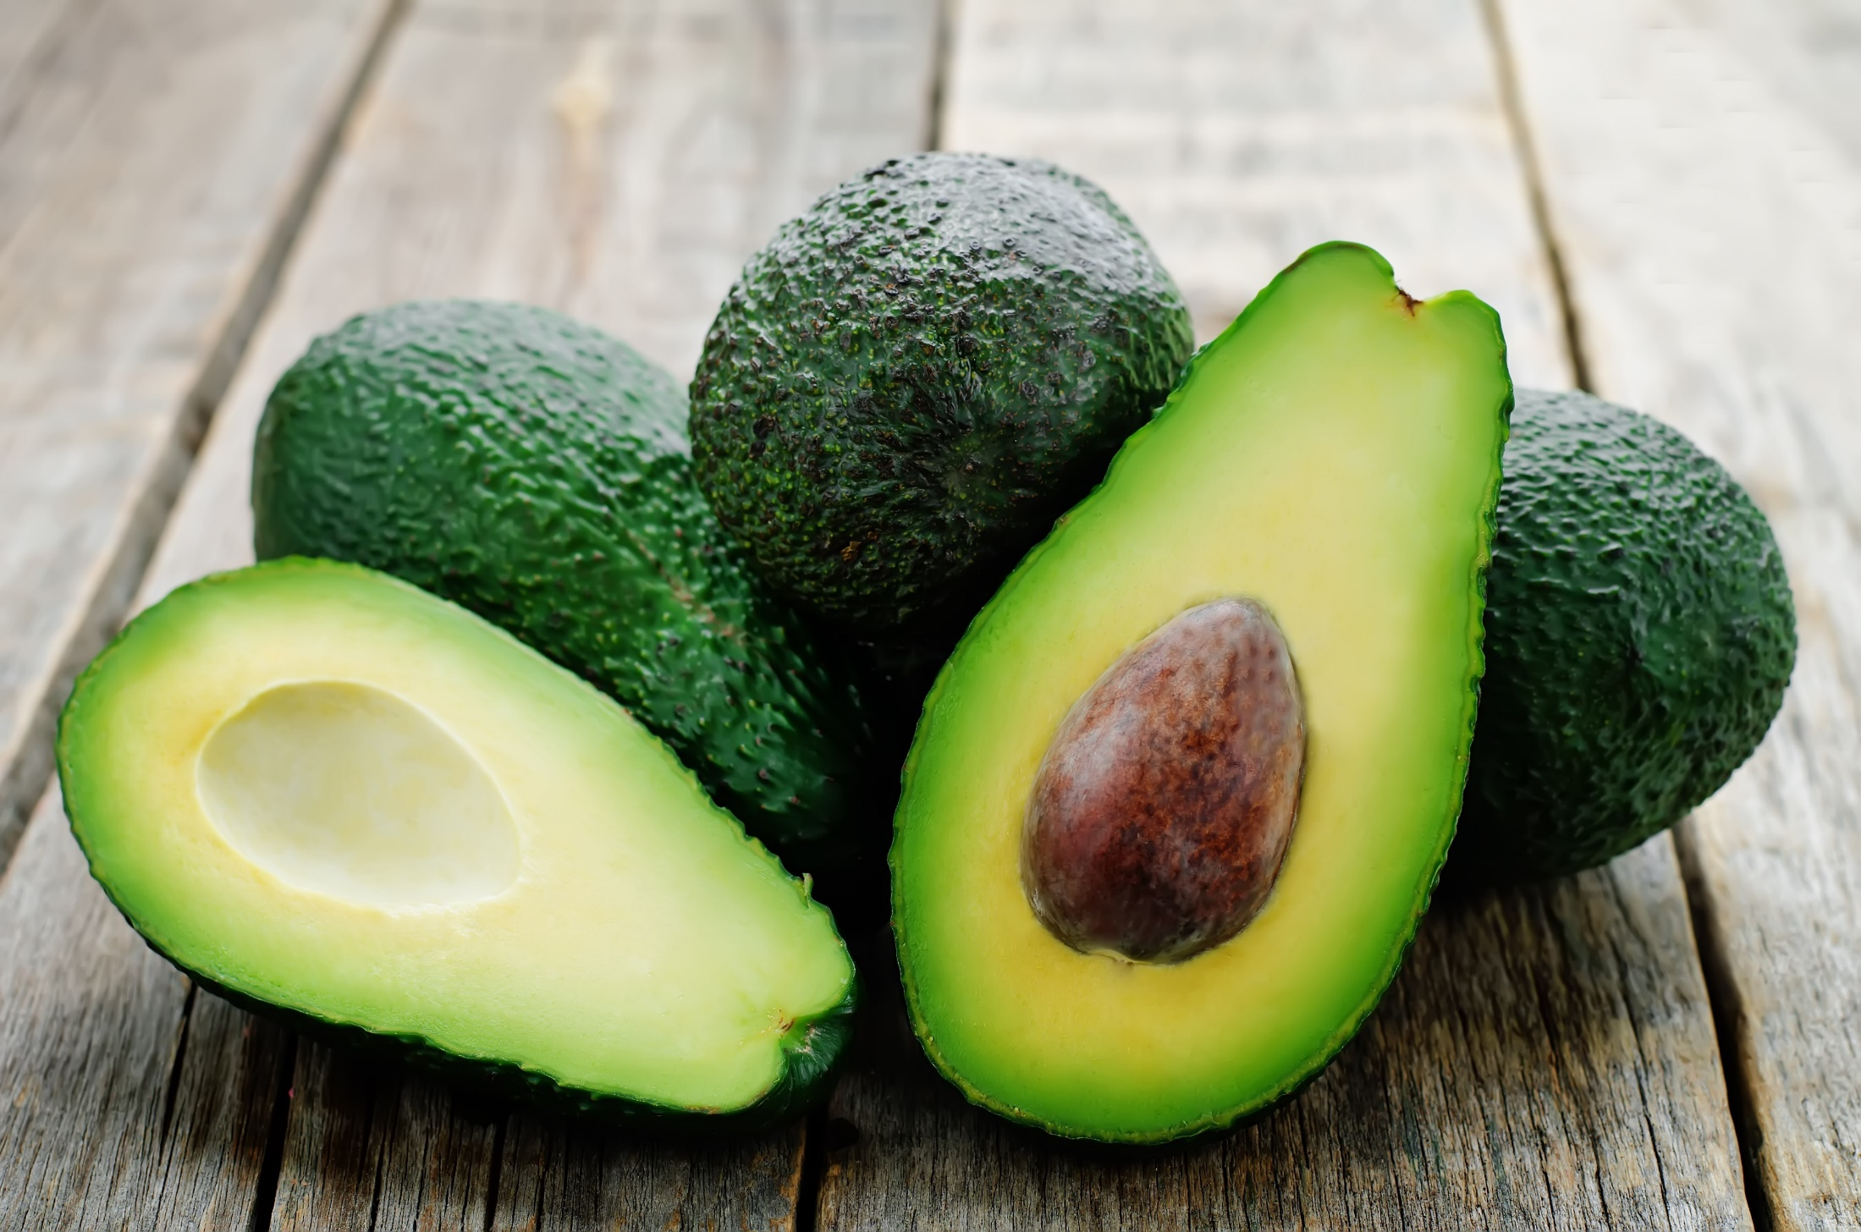
Green Foods
Color-code for GREEN: Circulation, cardiovascular
Notes:
SS 263066297

Slide 57
The Color Code of Green Foods
High in a variety of nutrients for cardiovascular health such as vitamin K (phylloquinone), folate, magnesium, potassium, and dietary nitrates
Flavonoid antioxidants like vitexin (found in green leafy vegetables) may have cardioprotective benefit.
Blood-vessel expanding
Relaxing due to vasodilatory properties
Binding and clearing
Minich DM, A Review of the Science of Colorful, Plant-Based Food and Practical Strategies for “Eating the Rainbow”, Journal of Nutrition and Metabolism, vol. 2019, Article ID 2125070, 19 pages, 2019. https://doi.org/10.1155/2019/2125070.

Slide 58
Green fruits & vegetables, select phytochemicals & physiological effects
Color | Fruits | Vegetables | Select Phytochemicals | Physiological Effects
Green | Avocado Grapes Green apples Limes Olives Pears | Artichokes Asparagus Bell peppers Bitter melon Bok choy Broccolini Cabbage Celery Cucumbers Edamame Green beans Green peas Greens Herbs Okra Sprouts Watercress | Chlorogenic acid Chlorophyll Flavonoids Folates Glucosinolates Isoflavones Isothiocyanates L-theanine Nitrates Oleocanthal Oleuropein Phytosterols Silymarin Sulforaphane Tyrosol Vitexin | Antioxidant Binding agents Blood vessel support Healthy circulation Methylation
Minich DM, A Review of the Science of Colorful, Plant-Based Food and Practical Strategies for “Eating the Rainbow”, Journal of Nutrition and Metabolism, vol. 2019, Article ID 2125070, 19 pages, 2019. https://doi.org/10.1155/2019/2125070.

Slide 59
Dietary sources of nitrates
1 serving of a high-nitrate vegetable can provide substantial NO production
Nitrate Content, mg/100 g of fresh weight | Vegetable varieties
Very low (<20) | Artichoke, asparagus, broad bean, eggplant, garlic, onion, green bean, mushroom, pea, pepper, potato, summer squash, sweet potato, tomato, watermelon
Low (20-50) | Broccoli, carrot, cauliflower, cucumber, pumpkin, chicory
Middle (50-100) | Cabbage, dill, turnip, Savoy cabbage
High (100-250) | Celeriac, Chinese cabbage, endive, fennel, kohlrabi, leek, parsley
Very high (>2,500) | Celery, cress, chervil, lettuce, red beetroot, spinach, rocket (rucola)
Table recreated from: Hord NG. Dietary nitrates, nitrites, and cardiovascular disease. Curr Atheroscler Rep. 2011 Dec;13(6):484-92. doi: 10.1007/s11883-011-0209-9
Notes:
Curr Atheroscler Rep. 2011 Dec;13(6):484-92. doi: 10.1007/s11883-011-0209-9.
Dietary nitrates, nitrites, and cardiovascular disease.
Hord NG¹.
Author information
Abstract
Dietary nitrate (NO(3)), nitrite (NO(2)), and arginine can serve as sources for production of NO(x) (a diverse group of metabolites including nitric oxide, nitrosothiols, and nitroalkenes) via ultraviolet light exposure to skin, mammalian nitrate/nitrite reductases in tissues, and nitric oxide synthase enzymes, respectively. NO(x) are responsible for the hypotensive, antiplatelet, and cytoprotective effects of dietary nitrates and nitrites. Current regulatory limits on nitrate intakes, based on concerns regarding potential risk of carcinogenicity and methemoglobinemia, are exceeded by normal daily intakes of single foods, such as soya milk and spinach, as well as by some recommended dietary patterns such as the Dietary Approaches to Stop Hypertension diet. This review includes a call for regulatory bodies to consider all available data on the beneficial physiologic roles of nitrate and nitrite in order to derive rational bases for dietary recommendations.

Slide 60
Vitamin K and the heart
Mostly known for role in coagulation (“koagulation”)
May play a role in arterial stenosis and calcification
Several forms of vitamin K:
  Phylloquinone (K-1): Found mostly in leafy greens but also in other plant foods: cashews, avocado, blueberries, blackberries, and lentils
  Menaquinone (K-2): Found in fermented foods, cheese, chicken liver, meat, eggs; gut microbiome can produce a small amount
Dietary intake is low
Can be further lowered through medications (e.g., warfarin, antibiotics, bile acid sequestrants)
Minich D. Why vitamin K is the next vitamin D. 2017. https://www.deannaminich.com/why-vitamin-k-is-the-next-vitamin-d/.
van Ballegooijen AJ, Pilz S, Tomaschitz A, Grübler MR, Verheyen N. The Synergistic Interplay between Vitamins D and K for Bone and Cardiovascular Health: A Narrative Review. Int J Endocrinol. 2017;2017:7454376.
Notes:
Helps in formation of proteins that bind ions of calcium
A vitamin-K dependent protein known as Matrix Gla-protein (MGP) can be found in atherosclerotic plaque and acts to prevent the precipitation of calcium; without vitamin K, protein cannot be made
Animal study found that those without MGP showed signs of massive aortic and coronary calcification, even while very young
Data from the longitudinal Rotterdam study data found increased intake of K-2 but not K-1 had an inverse relationship with aortic calcification and all-cause mortality
A study with postmenopausal found that intake of K-1 had a relative risk of 1.17 for coronary calcification, while intake of K-2 had a relative risk of 0.80
K2 might be even more essential for reducing risk of coronary calcification.

Slide 61
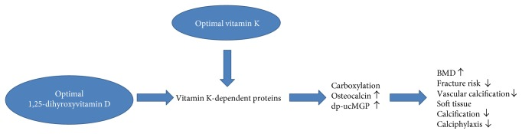
Is vitamin K the next ‘vitamin D’?
How do they work together?
Image Credit: van Ballegooijen AJ, Pilz S, Tomaschitz A, Grübler MR, Verheyen N. The Synergistic Interplay between Vitamins D and K for Bone and Cardiovascular Health: A Narrative Review. Int J Endocrinol. 2017;2017:7454376. doi:10.1155/2017/7454376. No changes made.
Notes:
Copyright © 2017 Adriana J. van Ballegooijen et al.
This is an open access article distributed under the Creative Commons Attribution License, which permits unrestricted use, distribution, and reproduction in any medium, provided the original work is properly cited.

Slide 62
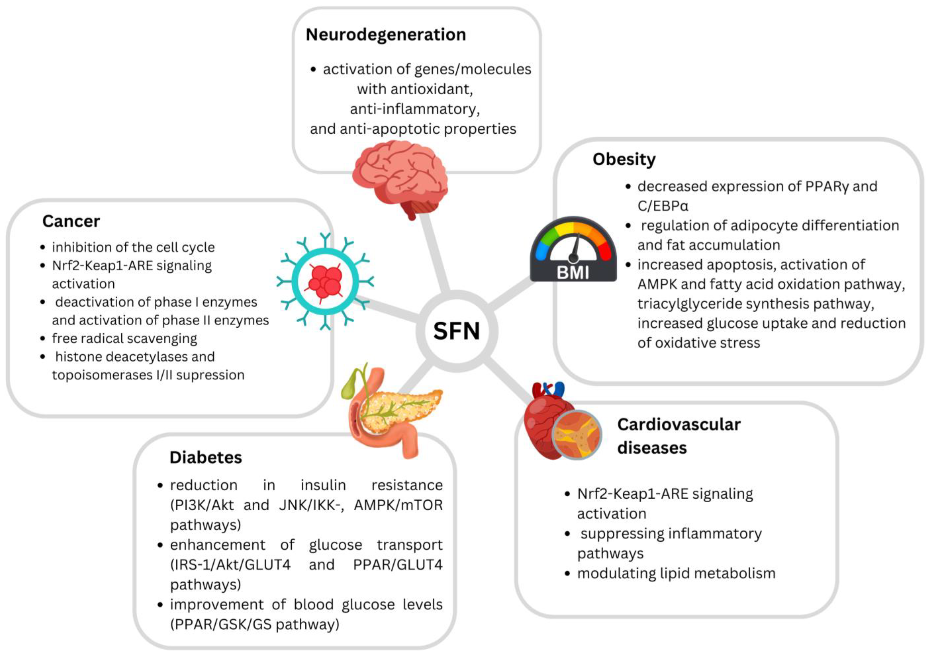
Cruciferous vegetables
Intake of cruciferous vegetables is associated with reduced cardiovascular mortality
High concentration of organosulfur compounds such as isothiocyanates and glucosinolates
Sulforaphane as one such isothiocyanate with favorable effects on CVD parameters due to its ability to modify inflammation, oxidative stress, and even blood clots.
Minich DM, A Review of the Science of Colorful, Plant-Based Food and Practical Strategies for “Eating the Rainbow”, Journal of Nutrition and Metabolism, vol. 2019, Article ID 2125070, 19 pages, 2019. https://doi.org/10.1155/2019/2125070; PMID: 29618474;
Baralić, K.; Živanović, J.; Marić, Đ.; Bozic, D.; Grahovac, L.; Antonijević Miljaković, E.; Ćurčić, M.; Buha Djordjevic, A.; Bulat, Z.; Antonijević, B.; et al. Sulforaphane—A Compound with Potential Health Benefits for Disease Prevention and Treatment: Insights from Pharmacological and Toxicological Experimental Studies. Antioxidants 2024, 13, 147. https://doi.org/10.3390/antiox13020147. Open access CC BY 4.0.
Notes:
Baralić, K.; Živanović, J.; Marić, Đ.; Bozic, D.; Grahovac, L.; Antonijević Miljaković, E.; Ćurčić, M.; Buha Djordjevic, A.; Bulat, Z.; Antonijević, B.; et al. Sulforaphane—A Compound with Potential Health Benefits for Disease Prevention and Treatment: Insights from Pharmacological and Toxicological Experimental Studies. Antioxidants 2024, 13, 147. https://doi.org/10.3390/antiox13020147
© 2024 by the authors. Licensee MDPI, Basel, Switzerland. This article is an open access article distributed under the terms and conditions of the Creative Commons Attribution (CC BY) license (https://creativecommons.org/licenses/by/4.0/).

Slide 63
GUIDELINES: Heart Health
Tend to inflammaging & coagulaging:
Anti-inflammatory diet
Emphasis on red & green foods
Stress management
Adequate sleep
Nourish the gut microbiome:
Dietary fiber
Fiber supplements
Pre- and pro-biotics
Polyphenols (plant foods)
Balance nutrients and reduce homocysteine:
Methylating agents
Omega-3 fatty acids
Vitamin K
Hydration
Cultivate emotional health:
Eating timeline
Creative outlets
Forest therapy (Vitamin N)

Slide 64
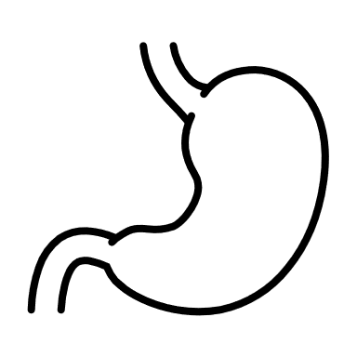
Clinical Conditions
Mind-Body Medicine
Gastric ulcer
Gastroesophageal reflux
Enzyme insufficiency
Fatty liver
Irritable Bowel Syndrome (IBS)
Inflammatory Bowel Disease (IBD)
Diarrhea
Constipation
Indigestion
Gut
Digestion, Detoxification, Elimination

Slide 65
Mind-Body Medicine
Select Root Causes to Address:
Sufficient digestion
Adequate detoxification
Regular elimination
Gut
Digestion, Detoxification, Elimination

Slide 66
Digestion
“Tending to Inner Fire”
Managing stress response
Engaging the senses
Producing adequate digestive secretions:
  Stomach acid, pancreatic enzymes, bile

Slide 67
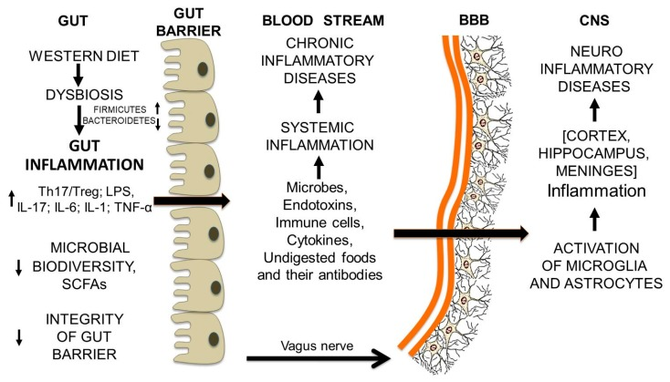
The Gut-Brain Axis
Image Credit: Riccio P, Rossano R. Undigested Food and Gut Microbiota May Cooperate in the Pathogenesis of Neuroinflammatory Diseases: A Matter of Barriers and a Proposal on the Origin of Organ Specificity. Nutrients. 2019;11(11):2714. Published 2019 Nov 9. doi:10.3390/nu11112714. Licensee MDPI, Basel, Switzerland. This article is an open access article distributed under the terms and conditions of the Creative Commons Attribution (CC BY) license (http://creativecommons.org/licenses/by/4.0/). Full-article link: https://www.ncbi.nlm.nih.gov/pmc/articles/PMC6893834/

Slide 68
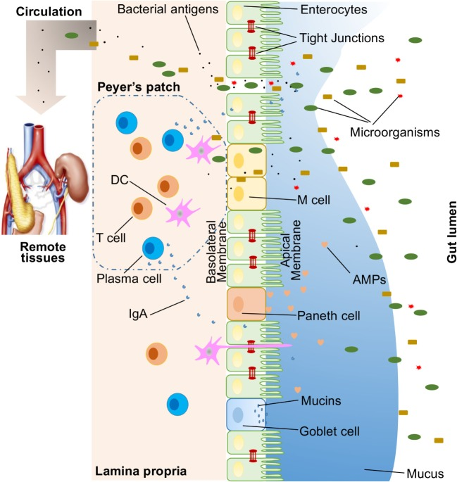
Leaky gut
& systemic inflammation
Image from: Mu Q, Kirby J, Reilly CM, Luo XM. Leaky gut as a danger signal for autoimmune diseases. Front Immunol. 2017;8:598. Published 2017 May 23. doi:10.3389/fimmu.2017.00598. No changes made. Creative Commons Attribution License (CC BY 4.0). https://creativecommons.org/licenses/by/4.0/
Notes:
Creative Commons
Article website https://www.frontiersin.org/articles/10.3389/fimmu.2017.00598/full
Copyright: © 2017 Mu, Kirby, Reilly and Luo. This is an open-access article distributed under the terms of the Creative Commons Attribution License (CC BY). The use, distribution or reproduction in other forums is permitted, provided the original author(s) or licensor are credited and that the original publication in this journal is cited, in accordance with accepted academic practice. No use, distribution or reproduction is permitted which does not comply with these terms.

Slide 69
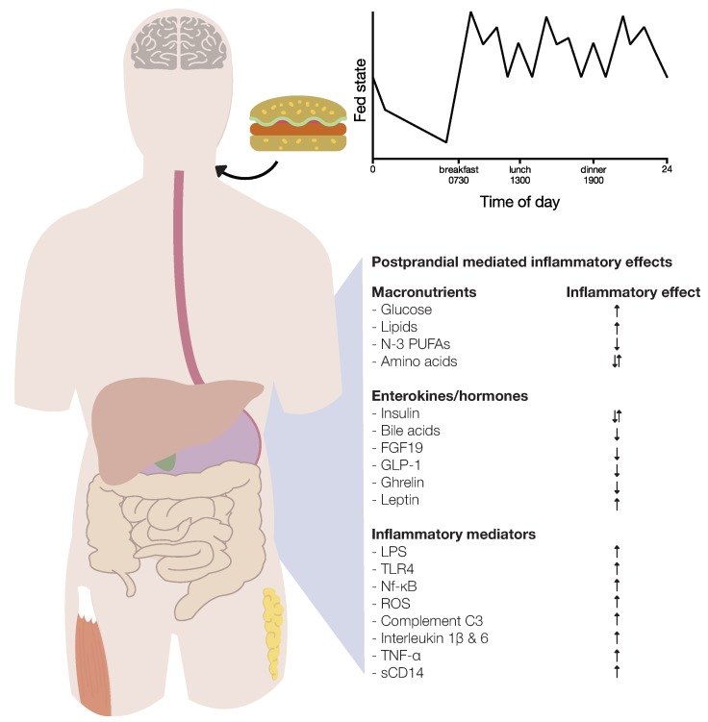
One meal can result in postprandial inflammation.
Image Credit: Meessen ECE, Warmbrunn MV, Nieuwdorp M, Soeters MR. Human Postprandial Nutrient Metabolism and Low-Grade Inflammation: A Narrative Review. Nutrients. 2019 Dec 7;11(12):3000. doi: 10.3390/nu11123000. PMID: 31817857; PMCID: PMC6950246. This article is an open access article distributed under the terms and conditions of the Creative Commons Attribution license CC BY 4.0
Notes:
The postprandial period as an endocrine, metabolic and inflammatory framework. Meal ingestion results in a complex and multifactorial endocrine and metabolic response, which influences postprandial inflammation via different pathways. Ingestion of glucose and lipids induces postprandial inflammation, whereas amino acids have pro- and anti-inflammatory effects. During the postprandial period, the enterokines insulin, bile acids, fibroblast growth factor 19 (FGF19), glucagon-like peptide- 1 (GLP-1) and ghrelin are released and exert anti-inflammatory effects on postprandial metabolism. Leptin mediates negative effects in adipose tissue. Insulin also has pro-inflammatory effects. Furthermore, as a result of nutrient ingestion, several mechanisms (i.e., lipopolysaccharide (LPS), Toll-like receptor 4 (TLR4), nuclear factor kappa-light-chain-enhancer-of activated B cells (Nf-κB), reactive oxygen species (ROS), complement component factor 3 (C3), interleukins, Tumor Necrosis factor (TNF)-α and soluble CD14 are activated or produced, and stimulate postprandial inflammation.
© 2019 by the authors. Licensee MDPI, Basel, Switzerland. This article is an open access article distributed under the terms and conditions of the Creative Commons Attribution (CC BY) license (http://creativecommons.org/licenses/by/4.0/).

Slide 70
Stress can get in the way of eating healthy.
Eating unhealthy creates more inflammation and stress.
Nakagawa M, Mizuma K, Inui T. Changes in taste perception following mental or physical stress. Chem Senses. 1996 Apr;21(2):195-200. doi: 10.1093/chemse/21.2.195. PMID: 8670698.; Newman E, O'Connor DB, Conner M. Daily hassles and eating behaviour: The role of cortisol reactivity status. Psychoneuroendocrinology. 2007 Feb;32(2):125-32. Epub 2007 Jan 2.
Notes:
HRV

Slide 71
Stress and the Gut
Effects of stress on the gut include:
alterations in motility (could be slower or faster);
visceral sensations (“butterflies in the stomach”);
alterations in secretions (higher or lower);
increase in intestinal permeability (“leaky gut”);
changes in intestinal cell turnover and blood flow;
changes to the microbiome
Konturek PC, Brzozowski T, Konturek SJ. Stress and the gut: Pathophysiology, clinical consequences, diagnostic approach and treatment options. J Physiol Pharmacol. 2011 Dec;62(6):591-9.

Slide 72
Chronic stress may lead to different gut-related diseases
Inflammatory bowel disease (IBD)
Irritable bowel syndrome (IBS)
Other functional gastrointestinal diseases
Food antigen-related adverse responses
Peptic ulcer and gastroesophageal reflux disease (GERD)
Konturek PC, Brzozowski T, Konturek SJ. Stress and the gut: Pathophysiology, clinical consequences, diagnostic approach and treatment options. J Physiol Pharmacol. 2011 Dec;62(6):591-9.
Notes:
J Physiol Pharmacol. 2011 Dec;62(6):591-9.
Stress and the gut: pathophysiology, clinical consequences, diagnostic approach and treatment options.
Konturek PC, Brzozowski T, Konturek SJ.
Source
Department of Medicine, Thuringia Clinic Saalfeld, Teaching Hospital of the University Jena, Germany. pkonturek@thueringen-kliniken.de
Abstract
Stress, which is defined as an acute threat to homeostasis, shows both short- and long-term effects on the functions of the gastrointestinal tract. Exposure to stress results in alterations of the brain-gut interactions ("brain-gut axis") ultimately leading to the development of a broad array of gastrointestinal disorders including inflammatory bowel disease (IBD), irritable bowel syndrome (IBS) and other functional gastrointestinal diseases, food antigen-related adverse responses, peptic ulcer and gastroesophageal reflux disease (GERD). The major effects of stress on gut physiology include: 1) alterations in gastrointestinal motility; 2) increase in visceral perception; 3) changes in gastrointestinal secretion; 4) increase in intestinal permeability; 5) negative effects on regenerative capacity of gastrointestinal mucosa and mucosal blood flow; and 6) negative effects on intestinal microbiota. Mast cells (MC) are important effectors of brain-gut axis that translate the stress signals into the release of a wide range of neurotransmitters and proinflammatory cytokines, which may profoundly affect the gastrointestinal physiology. IBS represents the most important gastrointestinal disorder in humans, and is characterized by chronic or recurrent pain associated with altered bowel motility. The diagnostic testing for IBS patients include routine blood tests, stool tests, celiac disease serology, abdominal sonography, breath testing to rule out carbohydrate (lactose, fructose, etc.) intolerance and small intestinal bacterial overgrowth. Colonoscopy is recommended if alarming symptoms are present or to obtain colonic biopsies especially in patients with diarrhoea predominant IBS. The management of IBS is based on a multifactorial approach and includes pharmacotherapy targeted against the predominant symptom, behavioural and psychological treatment, dietary alterations, education, reassurance and effective patient-physician relationship. When evaluating for the stress-induced condition in the upper GI tract, the diagnostic testing includes mainly blood tests and gastroscopy to rule out GERD and peptic ulcer disease. The therapy for these conditions is mainly based on the inhibition of gastric acid by proton pump inhibitors and eradication of Helicobacter pylori-infection. Additionally, melatonin an important mediator of brain gut axis has been shown to exhibit important protective effects against stress-induced lesions in the gastrointestinal tract. Finally, probiotics may profoundly affect the brain-gut interactions ("microbiome-gut-brain axis") and attenuate the development of stress-induced disorders in both the upper and lower gastrointestinal tract. Further studies on the brain-gut axis are needed to open new therapeutic avenues in the future.

Slide 73
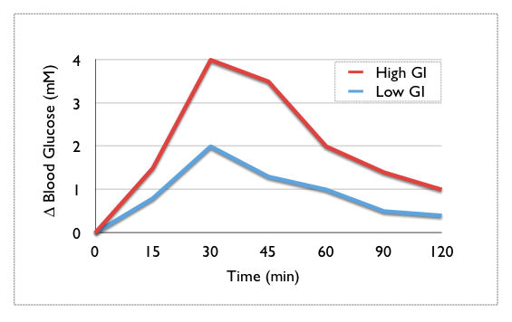
Blood glucose response to a food is connected to its inflammatory potential
https://commons.wikimedia.org/wiki/File:Glycemic.png#file. Illustration of the changes in blood glucose over time following a high and low GI carbohydrate. Designed and made Public Domain by Scott Dickinson (user: Studio34), Sydney, Australia.
Notes:
This work has been released into the public domain by its author, Studio34 at English Wikipedia. This applies worldwide.
In some countries this may not be legally possible; if so:
Studio34 grants anyone the right to use this work for any purpose, without any conditions, unless such conditions are required by law.
Dickinson, S. (2006, Aug 26). Glycemic image. https://commons.wikimedia.org/wiki/File:Glycemic.png#file

Slide 74
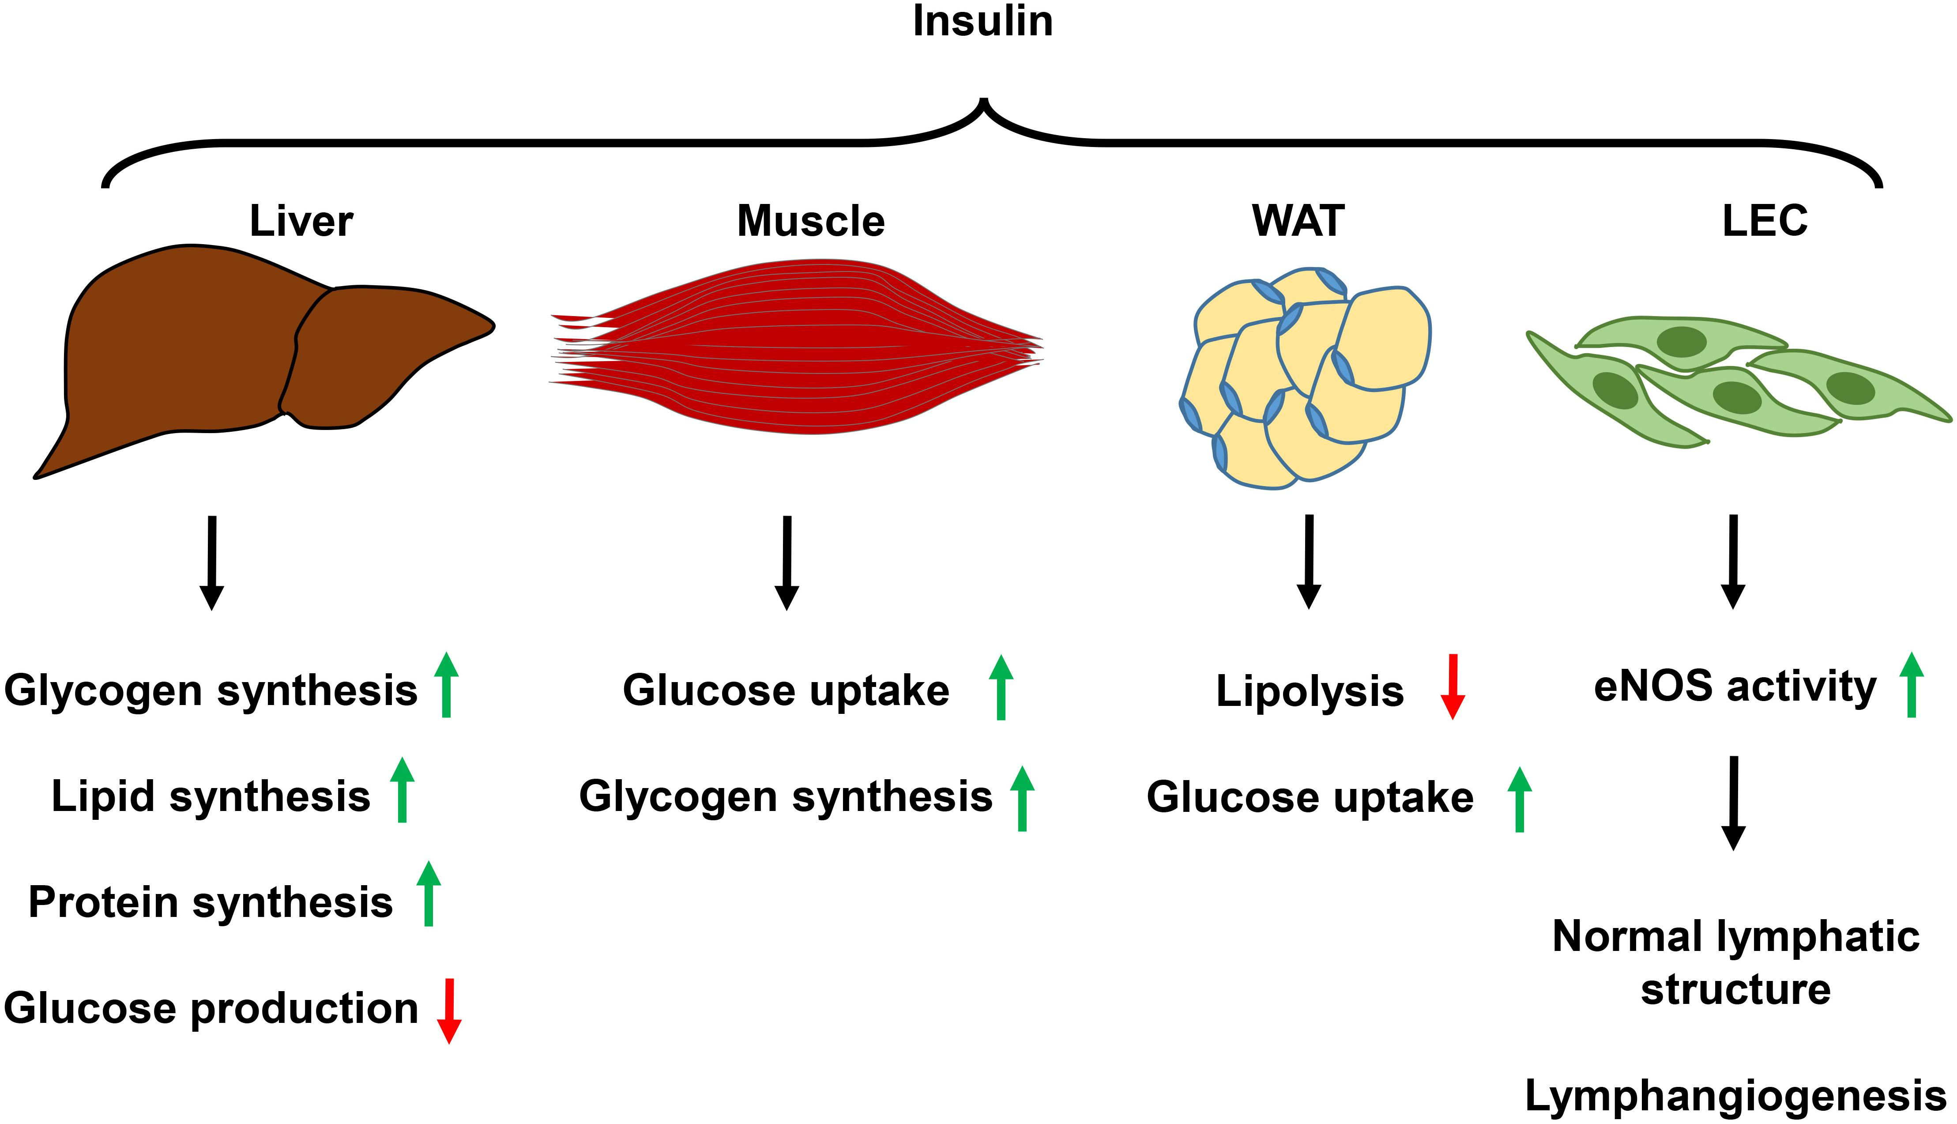
Image Credit: Jiang X, Tian W, Nicolls MR and Rockson SG (2019) The Lymphatic System in Obesity, Insulin Resistance, and Cardiovascular Diseases. Front. Physiol. 10:1402. doi: 10.3389/fphys.2019.01402. No changes made. Creative Commons.
Notes:
Copyright © 2019 Jiang, Tian, Nicolls and Rockson. This is an open-access article distributed under the terms of the Creative Commons Attribution License (CC BY).

Slide 75

Yellow Foods
Color-code for YELLOW: Metabolism, digestion

Slide 76
The Color Code of Yellow Foods
Bioflavonoids for healthy microorganisms and metabolic detoxification
Rich in fibers to support a complex microbiome and for sustained release of simple carbohydrates to modify glycemic impact
Assist in maintaining gastrointestinal health through gastric motility and/or digestive secretions
Minich DM, A Review of the Science of Colorful, Plant-Based Food and Practical Strategies for “Eating the Rainbow”, Journal of Nutrition and Metabolism, vol. 2019, Article ID 2125070, 19 pages, 2019. https://doi.org/10.1155/2019/2125070.

Slide 77
Yellow fruits & vegetables, select phytochemicals & physiological effects
Color | Fruits | Vegetables | Select Phytochemicals | Physiological Effects
Yellow | Apples Asian pears Bananas Lemons Pineapple Star fruit | Corn Ginger Potatoes (Yukon) Squash Yellow bell peppers Yellow onions | Bioflavonoids Bromelain Gingerol Lutein Nobiletin Prebiotic fibers Rutin Zeaxanthin | Antioxidant Digestive health Enzymatic activity Gastric motility Gut microbiome Glycemic impact
Minich DM, A Review of the Science of Colorful, Plant-Based Food and Practical Strategies for “Eating the Rainbow”, Journal of Nutrition and Metabolism, vol. 2019, Article ID 2125070, 19 pages, 2019. https://doi.org/10.1155/2019/2125070.

Slide 78
Ginger Rhizome
(Zingiber officinale)
Anti-inflammatory
May increase gastric motility and help with constipation
Ginger constituents seem to act on serotonin and muscarinic receptors in the GI tract
  Can cause GI irritation
Potential nervous system activity
Hypoglycemic, hypocholesterolemic, anthelmintic, gastroprotective, and antiplatelet effects; therefore, there could be interactions and potentiation when used with drugs that have the same activities
Anh, N.H.; Kim, S.J.; Long, N.P.; Min, J.E.; Yoon, Lee, E.G.; Kim, M.; Kim, T.J.; Yang, Y.Y.; Son, E.Y.; Yoon, S.J.; Diem, N.C.; Kim, H.M.; Kwon, S.W. Ginger on Human Health: A Comprehensive Systematic Review of 109 Randomized Controlled Trials. Nutrients 2020, 12, 157; Natural Medicines Database.
Notes:
Certain constituents of ginger might inhibit cyclooxygenase (COX) and lipoxygenase pathways, and leukotrienes (7401,18210). It may also inhibit tumor necrosis factor (TNF)-alpha (12473). It also seems to inhibit the synthesis of prostaglandin-E2 (PGE2) and thromboxane B2 (TXB2), which mediate inflammation (12634).

Slide 79
Citrus Fruits (Lemons)
Acidic content may be helpful for digestive health pH requirements
Glycemic response to starch-rich meals can be reduced by 20-50% with acidic drinks or foods
Intake of citrus fruits associated with reduced risk of esophageal and gastric cancers
Protective phytonutrients against gastric ulcer (e.g., hesperidin, nobiletin, rutin)
Metabolic effects of citrus-based phytonutrients like naringenin
Minich DM, A Review of the Science of Colorful, Plant-Based Food and Practical Strategies for “Eating the Rainbow”, Journal of Nutrition and Metabolism, vol. 2019, Article ID 2125070, 19 pages, 2019. https://doi.org/10.1155/2019/2125070.

Slide 80
Pineapple
Contains bromelain, a proteolytic enzyme, shown to be helpful in digesting food contents (1)
Shown in animal studies to have anti-inflammatory, anti-microbial, antibiotic potentiation, anti-helmintic, anti-diarrheal, anti-ulcer, and liver supportive effects (2)
Minich DM, A Review of the Science of Colorful, Plant-Based Food and Practical Strategies for “Eating the Rainbow”, Journal of Nutrition and Metabolism, vol. 2019, Article ID 2125070, 19 pages, 2019. https://doi.org/10.1155/2019/2125070.
Chakraborty AJ, Mitra S, Tallei TE, et al. Bromelain a Potential Bioactive Compound: A Comprehensive Overview from a Pharmacological Perspective. Life (Basel). 2021;11(4):317. Published 2021 Apr 6. doi:10.3390/life11040317
Notes:
Turk J Gastroenterol. 2013;24(4):330-3.
Incomplete stomach emptying as a complication of intragastric balloon treatment and a solution suggestion: Pineapple juice drinking.
Simşek Z1, Altınbaş A, Delibaşı T, Yüksel O.
Author information
Abstract
BACKGROUND/AIMS:
During removal of intragastric balloon, there is a great deal of gastric undigested food even after an eight-hour starvation. Bromelain, a proteolytic enzyme existing in the pineapple juice seems to be a good choice for the undigested food remnants in the stomach. We aimed to investigate the effect of drinking pineapple juice on dissolving food remnants in patients undergoing endoscopic procedure for removal of intragastric balloon.
MATERIALS AND METHOD:
In this study, we included patients who had undergone endoscopic placement of intragastric balloon (BIB®, BioEnterics Intragastric Balloon, Inamed Health, CA, USA) between February 2009 and March 2012. First 8 patients were asked to fast the whole night before the procedure (at least 8 hours) and to apply clear liquid diet for 3 days before the endoscopic removal. A great amount of food remnants was seen in the stomach during the endoscopic balloon removal procedure. A second endoscopic procedure was planned 3 days later and, in order to decrease the food remnants, the patients were asked to drink 1 L pineapple juice per day. The next 11 patients were also advised to drink 1 liter per day of 100% pineapple juice for 3 days before the endoscopic removal.
RESULTS:
Totally, 19 obese patients (17 female, 2 male) were included in the study. Mean age was 38,68±7,95 years, mean weigh was 124,23±19,30 kg, and mean body mass index was 49,73±9,22 kg/m 2 . There was undigested food in the stomach during endoscopic removal in the first 8 patients. However, no undigested food in the stomach was found at the second endoscopic examination. In the other 11 patients, no food remnants were observed after taking pineapple juice prior to the endoscopic removal procedure.
CONCLUSION:
Drinking pineapple juice for 3 days before endoscopic balloon removal seems to be effective in dissolving food remnants in the stomach. Drinking pineapple juice may be recommended in all patients undergoing endoscopic procedure for removal of intragastric balloon.

Slide 81
Adequate Detoxification
“Removing toxic burden”
Adequate protein and phytonutrients for phase I and II
Probiotics in the gut for removal
Dietary fibers to bind

Slide 82
Gut health:
Elimination diet
What is an “elimination diet”?
As used in functional medicine, a defined time period of removing typical dietary offenders: corn, soy, wheat, gluten, alcohol, sugar, eggs, shellfish, overly cooked foods, peanuts, dairy, processed oils, coffee; followed by a reintroduction period to observe symptoms.
Useful in food allergy, atopy, eczema
Migraine, headaches, neurological & behavioral issues (e.g., ADHD)
Gut disorders and dysfunction (e.g., IBS, leaky gut)
Fibromyalgia
PMID:25339342, 22391333, 21717823
Notes:
J Headache Pain. 2014 Oct 23;15:69. doi: 10.1186/1129-2377-15-69.
Gastroenterology. 2012 Jun;142(7):1451-9.e1; quiz e14-5. doi: 10.1053/j.gastro.2012.03.001. Epub 2012 Mar 3.
Altern Ther Health Med. 2011 Mar-Apr;17(2):36-44.
Bunner, A. E., Agarwal, U., Gonzales, J. F., Valente, F., & Barnard, N. D. (2014). Nutrition intervention for migraine: A randomized crossover trial. The journal of headache and pain, 15(1), 69. https://doi.org/10.1186/1129-2377-15-69; PMID: 25339342
Gonsalves, N., Yang, G. Y., Doerfler, B., Ritz, S., Ditto, A. M., & Hirano, I. (2012). Elimination diet effectively treats eosinophilic esophagitis in adults; food reintroduction identifies causative factors. Gastroenterology, 142(7), 1451–e15. https://doi.org/10.1053/j.gastro.2012.03.001; PMID: 22391333
Lamb, J. J., Konda, V. R., Quig, D. W., Desai, A., Minich, D. M., Bouillon, L., Chang, J. L., et al. (2011). A program consisting of a phytonutrient-rich medical food and an elimination diet ameliorated fibromyalgia symptoms and promoted toxic-element detoxification in a pilot trial. Alternative Therapies in Health and Medicine, 17(2), 36–44. PMID: 21717823

Slide 83
Clinical Tool: Variety Tracker
“Increasing the diversity of brightly-coloured plant foods, even in small amounts, can have a dramatic effect on SCFA production.”
Quote: Toribio-Mateas, M. Harnessing the Power of Microbiome Assessment Tools as Part of Neuroprotective Nutrition and Lifestyle Medicine Interventions. Microorganisms 2018, 6, 35. https://doi.org/10.3390/microorganisms6020035

Slide 84
Regular Elimination
Hydration
Dietary soluble and insoluble fibers
Magnesium
Managing emotions and stress response

Slide 85
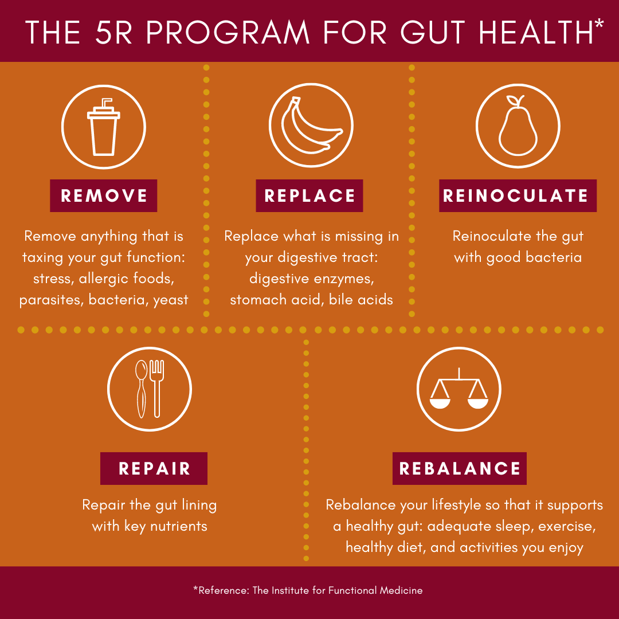
Improving digestion through the Functional Medicine 5Rs
Remove
Replace
Reinoculate
Repair
Relax

Slide 86
GUIDELINES: Gut Health
Tend to inner fire (digestion):
Not overeating
Eating with circadian rhythm
Mindful eating
Eliminate toxic offenders
Replace enzymes and acid
Nourish the terrain:
Dietary fiber
Fiber supplements
Pre- and pro-biotics
Polyphenols (plant foods)
Balance nutrients and blood sugar:
Dietary fiber
Yellow foods
Reduce high-sugar foods
Detoxify:
Avoid toxic inputs
Ensure adequate protein
Include plants for phytonutrients
Eat with diversity
Hydrate

Slide 87
Mind-Body Medicine
Brain
Heart
Gut
Mood, Sleep, Thought
Breath, Circulation, Oxygenation
Digestion, Detoxification, Elimination

Slide 88
Summary
The brain, heart, and gut are interrelated systems that function together as a whole.
There are common mechanisms that connect these three systems: inflammation, stress, and nutrition.
A holistic nutrition and lifestyle medicine program can help to benefit these body systems.

Slide 89
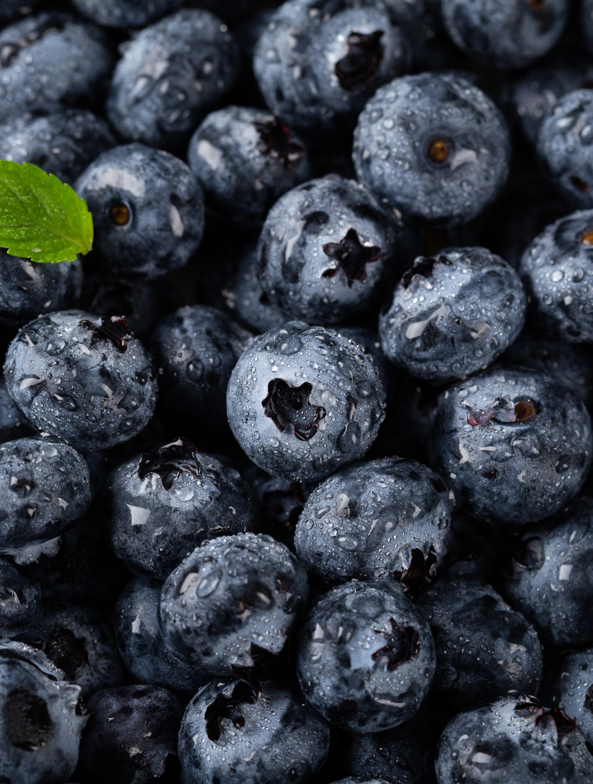
OBRIGADA!
www.nutricaoin.com.br
89

